Slide 1
Radiation, Exposure, and Risk

Slide 2
A Radiation Primer
What is radiation?
What is radioactive material?
Difference between radiation exposure and radiation contamination

Slide 3
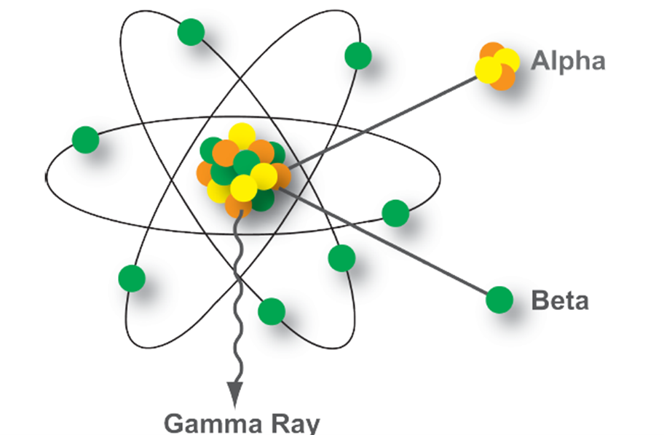
The Radioactive Atom
Notes:
The 3 major types of radiation have different abilities to penetrate matter.
[use pointer] Alpha particles about an inch in air andcan be stopped by a thin layer of paper or clothing, or the outer layer of skin. As a result, they are not considered an external hazard to people, but they can damage tissue if they get inside the body.
[use pointer] Beta particles can travel from inches to many feet in air. Beta emitting contaminants on the skin may cause skin injury, and beta particles may be harmful if they get inside the body.
[use pointer] Gamma rays travel many feet in air and many inches in human tissue. Thick layers of concrete or lead are needed to shield against gamma radiation.
Dr. Jones will be talking in more detail about the laboratory detection methods,

Slide 4
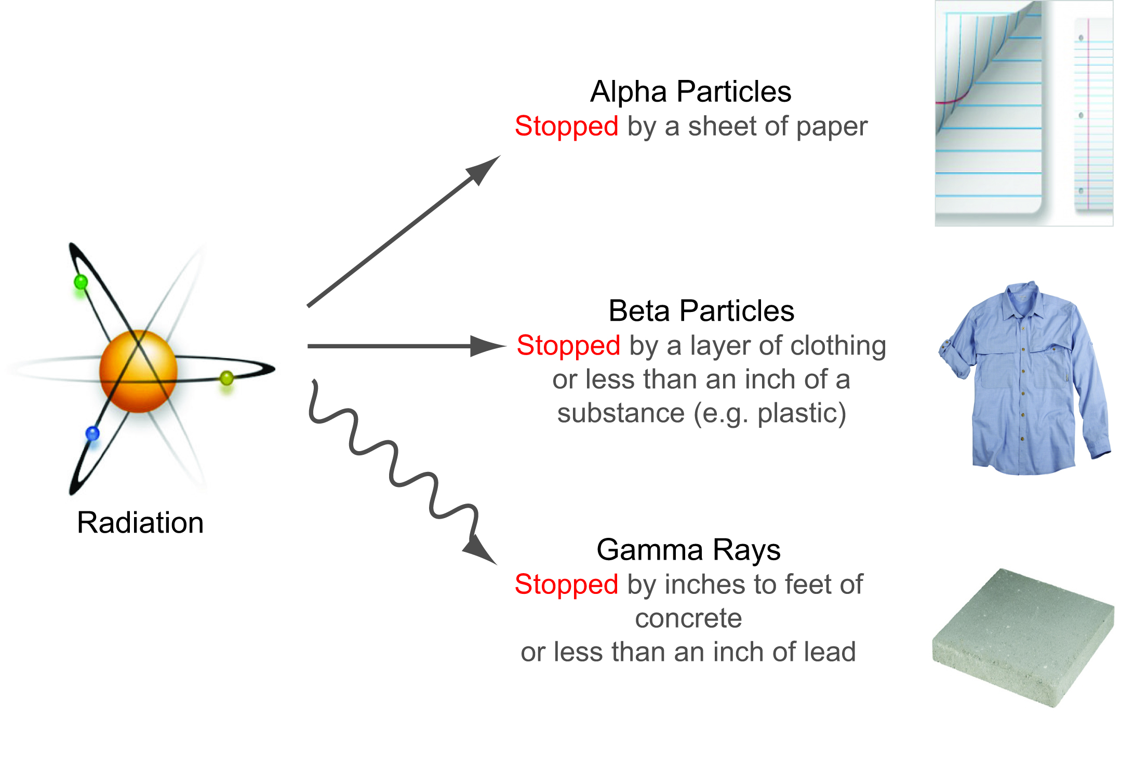
Penetration Abilities
Especially damaging to internal tissues if inhaled or swallowed
Damaging to internal tissues if inhaled or swallowed and can cause external skin burns
Damaging to tissues externally and internally
Notes:
The 3 major types of radiation have different abilities to penetrate matter.
[use pointer] Alpha particles about an inch in air andcan be stopped by a thin layer of paper or clothing, or the outer layer of skin. As a result, they are not considered an external hazard to people, but they can damage tissue if they get inside the body.
[use pointer] Beta particles can travel from inches to many feet in air. Beta emitting contaminants on the skin may cause skin injury, and beta particles may be harmful if they get inside the body.
[use pointer] Gamma rays travel many feet in air and many inches in human tissue. Thick layers of concrete or lead are needed to shield against gamma radiation.
Dr. Jones will be talking in more detail about the laboratory detection methods,

Slide 5


Slide 6

Alpha Particles
Internal hazard only, harmful when inside body
Former Russian spy Litvinenko fell ill on November 1 & died November 23, 2006 after
Po-210 poisoning
ALPHA PARTICLES…
Have large mass, can’t penetrate skin
Very short travel distance
Shielded by paper
Harmful when inhaled or ingested
Notes:
Hi ionizing potential / big particle/ only comes from heavy elements
Gives up all it’s energy within short span due to large mass and charge ( +2)
4-7 MeV.
Travels about 2 inches in air

Slide 7
Beta Particles
Internal and external hazard
Can penetrate into skin but not to deep organs
Short travel distance ~ 10 ft in air
Shielded by ¼ “ plastic or thin metal
Notes:
Virtually all radioisotopes are capable of Beta decay
Carry neg or positive charge (positrons)
Travel about a yard in air, about 1-2 cm of soft tissue

Slide 8
Neutrons
Neutrons needed for chain reaction in
nuclear reactors and nuclear bombs
Energetic and destructive to cells
Rarely occurs from natural radioactive materials
Can travel long distances
Shielded with hydrogenous materials (water, poly, etc.)
10 Inches of Plastic
1 foot of Concrete
3 feet of Dirt
3 feet of Water
Notes:
Neutron radiation consists of free neutrons. Neutrons may be emitted during nuclear fission (either spontaneous or triggered), nuclear fusion, very high energy reactions such as in a Spallation Neutron Source, or from certain other reactions, most famously the (α,n) reaction, for example when a beryllium nucleus absorbs an alpha particle and emits a neutron.
Another, sometimes more severe, hazard of neutron radiation is neutron activation, the ability of neutron radiation to induce radioactivity in most substances it encounters, including the body tissues of the workers themselves. This occurs through the capture of neutrons by atomic nuclei, which are transformed to another nuclide, frequently a radionuclide. This process accounts for much of the radioactive material released by the detonation of a nuclear weapon. It is also a problem in nuclear fission and nuclear fusion installations, as it gradually renders the equipment radioactive; eventually the hardware must be replaced and disposed of as low-level radioactive waste.

Slide 9
Gamma and/or X-Rays
Biggest concern for public safety
Both are penetrating radiation and travel long distances
Can penetrate walls and entire body giving deep dose to organs
Shielded by dense materials
1 ft Soil
6 “ Concrete
3 “ Steel
1 “ Lead
Notes:
Both are electromagnetic radiation. Part of the spectrum with radio waves on the low portion of the spectrum, going thru microwaves, then infrared, visible, ultraviolet, x rays, and then gamma.
Only difference between x and gamma is their origin.
No mass, no charge
An x-ray machine, like that used in a doctor's or a dentist's office, is really very simple. Inside the machine is an x-ray tube. An electron gun inside the tube shoots high energy electrons at a target made of heavy atoms, such as tungsten. X-rays come out because of atomic processes induced by the energetic electrons shot at the target.

Slide 10
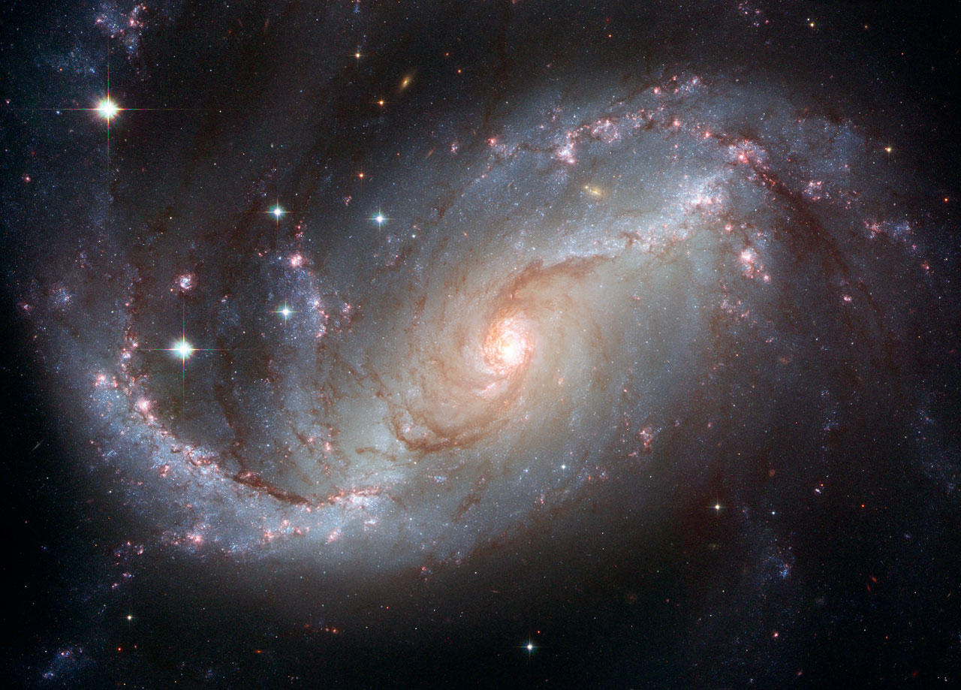
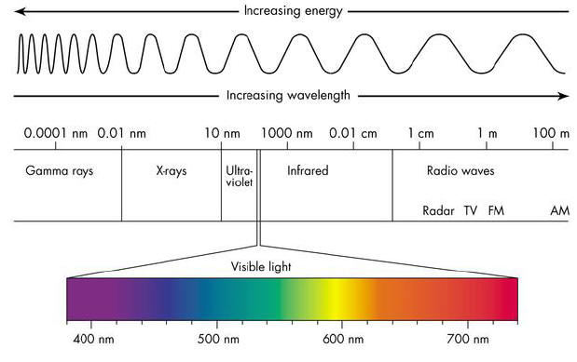
Electromagnetic Radiation ”energy with wave like behavior”
all travel at the speed of light

Slide 11
Dose and Dose Rate
Dose = total amount of radiation received (like the odometer in your car, which records the total number of miles traveled)
Dose Rate = amount of radiation received over a time period (like the speedometer in your car, which records current speed – or the rate at which miles are being traveled)

Slide 12
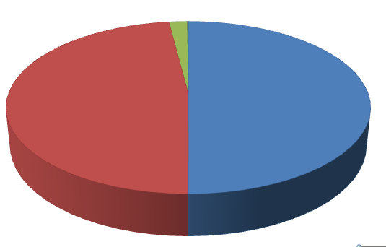
Average Annual Radiation Dose in U.S. 6.2 mSv = 620 mrem
Consumer products, occupational
2%
Natural background
50%
Medical
48%
Source: NCRP Report No. 160, Ionizing Radiation Exposure of the Population of the United States (2009)

Slide 13
Estimated Annual Radiation Dose to the U.S. Population
~620 mrem/yr (322 NORM/298 medical)
( equates to about 62 chest x-rays)
Average for smokers (1 pack/day)
1300 mrem/yr
http://www.epa.gov/radiation/students/calculate.html
Source: NCRP 161

Slide 14
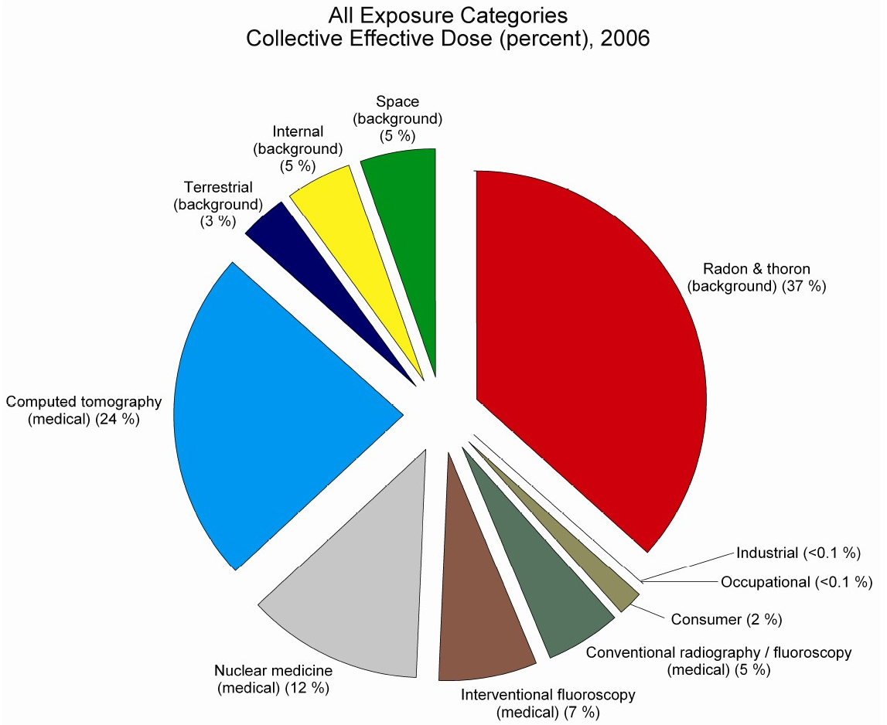
Source of Average Radiation Dose

Slide 15
Average Annual Radiation Dose by Occupation
Airline flight crewmember = 1000 mrem
Nuclear power plant worker = 160 mrem
Grand Central Station worker = 120 mrem
Medical personnel = 70 mrem
Average DOE worker = 44 mrem
Limit to radiation worker = 5000 mrem

Slide 16
Typical Doses (mrem)
Airport Screening 0.010
NY to London by air 5
Chest X-Ray 10
Natural bkgd. (annual) 300
CT Scan -Abdomen 1,000
Occupational annual limit 5,000
50% survival (whole body) 400,000
Radiotherapy (tumor) 8,000,000
Notes:
“Rem” is the most common dose unit used in America (Note: this is changing; eventually it will likely be the “Sievert ‘as in the rest of the world.)
When we specify radiation dose in terms of a rem, we are taking account of the fact that different types of radiation can have varying biological effects.
In this table we get a feel for how big or small a rem is.
Note that the very large doses delivered in radiotherapy represent the dose to the tumor, not to the whole body. The objective is to kill all tumor cells while leaving the surrounding healthy tissue with little or no radiation dose.
In general, we would say that a chest x-ray delivers about 10 millirem of radiation dose.

Slide 17
Contamination ?
Contamination is radioactive material in an undesirable location.
Notes:
You’re smelling somebody’s cologne – you’re exposed
Some of that cologne accidently get’s splashed on you – you’re contaminated

Slide 18


Slide 19
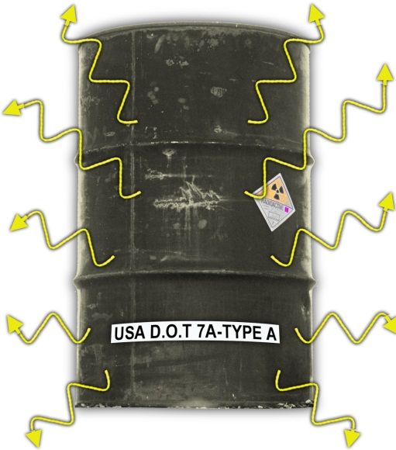
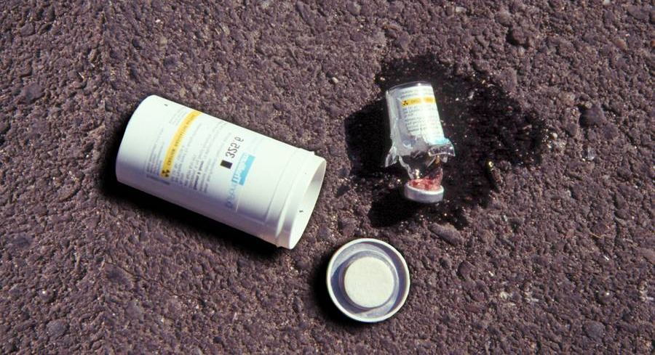
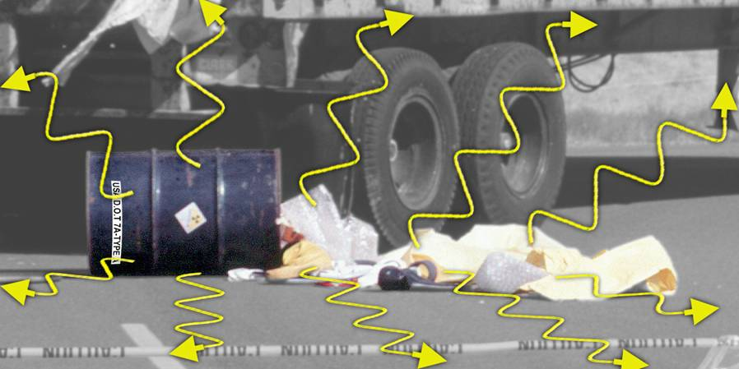
Radiation is a type of energy; Contamination is material
Notes:
Narrative
Emphasize: A person exposed to radiation does not become radioactive. When you get an X-ray at the doctor’s office, it does not make you radioactive.
Getting a radiation exposure is just like going to the beach and being exposed to sunshine. The light rays may deposit enough energy into you body to cause an effect, like a sun burn, but when you turn off the lights that night you will not be glowing.
Contamination is Radioactive Material spilled someplace you don’t want it. For example it can be the spilt vial of the radioactive liquid of radiopharmaceutical pictured above, or it can be dust of even chunks of radioactive material wherever it is not wanted.
Even when spread around the radioactive material in the Contamination still emits radiation.
Contamination can get on you.
If you walk through it, touch it, or breath airborne contamination; it may get on, or inside of you.
The contamination may be too small to be visible.

Slide 20
Controlling Radiation Dose
Time (half the time = half the dose)
Distance (dose falls off as the square of the distance = 1/r²)
Shielding

Slide 21
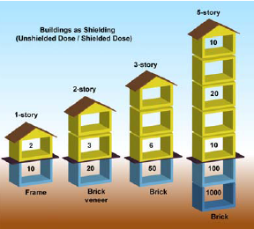
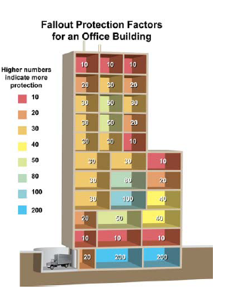
Shielding
Source: Planning Guidance for Response to a Nuclear detonation, 2010.
Notes:
21
Mention car
Lead, soil, sand
Which floor of a building, basement, top floor, middle floor, middle of the room.

Slide 22
Human Health Effects
Depending on radiation dose, dose rate, and other parameters (e.g., age):
Acute effects (acute radiation syndrome)
Effects are greater on rapidly dividing cells
Late effects (cancer)
No observable effects
Notes:
Radiation exposure does not necessarily result in any observable or clinical effects. But keep in mind, it can increase one’s chance of getting a cancer, depending on the radiation dose.
As with toxicology, it is the “dose that makes the poison.”

Slide 23
Latent Effects
Cancers: leukemia, breast, thyroid, salivary glands, stomach, colon, lung (& others)
Young age at exposure increases risk
Risk persists throughout life
Notes:
First cancer attributed to ionizing radiation exposure was on the hand of radiologist in 1902
Leukemia was first associated with chronic exposure in studies of radiologists (1944)
There are no novel cancers induced by radiation exposure. The cancers induced are those we already know about.
Children exposed have greater risks due to higher cellular proliferation rates in many organs and to the fact that there are many more years available for a radiation-induced cancer to be expressed.
Once exposed, the risk of a radiation-induced cancer does not go away. (Compare with tobacco smoking: when one stops smoking, the risk of lung cancer declines as the years go by.)

Slide 24
Review Fundamentals
Difference between:
– Radioactive material
– Radiation
Difference between being:
– Contaminated
– Irradiated (exposed)
External &
Internal

Slide 25
Key Points
Radiation types: alpha, beta, gamma, neutron
Radiation and radioactivity are part of our natural environment
Radioactive contamination is not immediately life threatening.
Decontamination is relatively simple.

