Slide 1
Response Overview and
Population Monitoring
Presentation to: RRVC Hands-On Training Workshop
Presented by: Betsy T. Kagey, PhD
Date: November 16th, 2013

Slide 2
Response and Population Monitoring
Role of Public Health
Overview of response
Population monitoring

Slide 3
Georgia Public Health
Health Promotion and Disease Prevention
Maternal and Child Health
Infectious Disease and Immunization
Environmental Health
Epidemiology
Emergency Preparedness and Response
Emergency Medical Services
Pharmacy
Nursing
Volunteer Health Care
Office of Health Equity
Vital Records
State Public Health Laboratory.

Slide 4

Public Health’s Role in Response Emergency Support Functions (ESF)
ESF #1 - Transportation
ESF #2 - Communications
ESF #3 - Public Works and Engineering
ESF #4 - Firefighting
ESF #5 - Emergency Management
ESF #6 - Mass Care, Emergency Assistance, Housing and Human Services
ESF #7 - Logistics Management and Resource Support
ESF #8 - Public Health and Medical Services
ESF #9 - Search and Rescue
ESF #10 - Oil and Hazardous Materials Response
ESF #11 - Agriculture and Natural Resources
ESF #12 - Energy
ESF #13 - Public Safety and Security
ESF #14 - Long-Term Community Recovery
ESF #15 - External Affairs

Slide 5
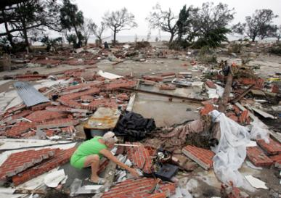
Public Health Functions After Any Disaster
Rapid assessment of health and medical needs
Sheltering and housing, mass care safety
Injury and illness surveillance
Potable water, safe food, sanitation and hygiene
Vector control
Solid waste, waste water management
Hazardous material disposal
Registry
Handling of the deceased
Rumor control
Public service announcements
Notes:
5
Design, implementation, and interpretation of results from environmental field surveys, laboratory analyses.

Slide 6
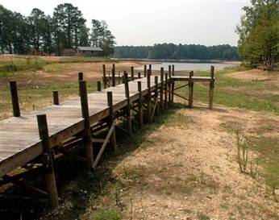
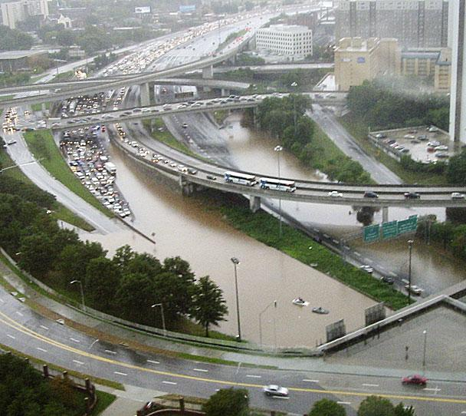
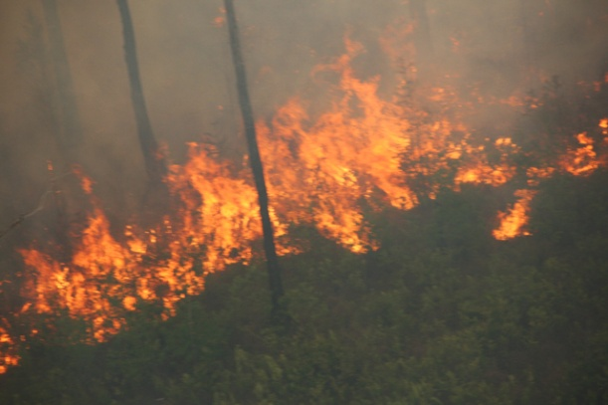
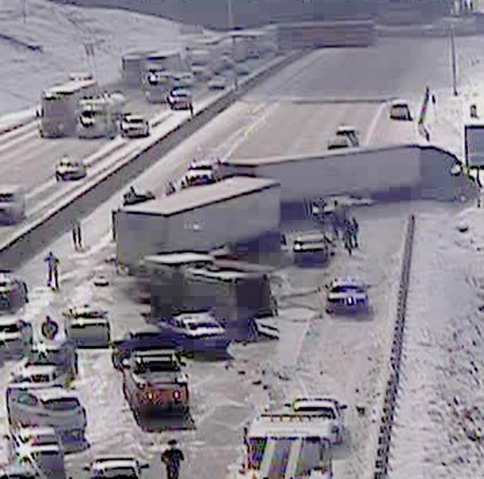
…Georgia’s Four Seasons of Climate Change…
Drought
Floods
Wildfires
Ice storms

Slide 7
Role of Public Health Emergency Support Function (ESF) 8
Disease Surveillance and Monitoring
Health Information and Communication
General Health Impacts
Vulnerable Populations
Support to Healthcare Facilities
Guidance

Slide 8
Surveillance
Epidemiologic surveillance is
“ongoing systematic collection, analysis, and interpretation of health data essential to the planning, implementation, and evaluation of public health practice, closely integrated with the timely dissemination of these data to those who need to know.”
CDC

Slide 9
Routine Disease Surveillance
The Georgia Division of Public Health, its Public Health Districts, Boards of Health and/or local health departments are responsible for surveillance, early detection of disease outbreaks, and response activities.
Disease surveillance operations are conducted routinely.

Slide 10
Why is surveillance important
Surveillance information has many uses:
Monitoring disease trends
Describing natural history of diseases
Identifying epidemics or new syndromes
Monitoring changes in infectious agents
Identifying areas for research
Evaluating hypotheses
Planning public health policy
Evaluating public health policy/interventions

Slide 11
Population Monitoring
A process that begins soon after a radiation incident is reported and continues until all potentially affected people have been monitored and evaluated for:
• Needed medical treatment.
• The presence of radioactive contamination on the body or clothing.
• The intake of radioactive materials into the body.
• The removal of external or internal contamination (decontamination).
• The radiation dose received and the resulting health risk from the exposure.
• Long-term health effects.
Assessment of the first five elements listed above should be accomplished as soon as possible following an incident.
Long-term health effects are usually determined through a population registry and an epidemiologic investigation that will likely span several decades.
http://emergency.cdc.gov/radiation/pdf/population-monitoring-guide.pdf

Slide 12
Version 3-29-11
Airport Screening of
Incoming Passengers
from Japan March, 2011
CBP screens passenger
If > 20 x background
If >2 and < 20 background
CBP contacts CDC and SRC for immediate consultation
Data sent to CDC
CDC contacts
SRC*
SRC
performs Rad Assessment
If necessary, SRC collects Urine for Bioassay
SRC or SHD collects Epi Questionnaire
SRC sends urine to SHDL
CBP: Customs and Border Patrol SRC: State Radiation Control
SHD: State Health Department
SHDL: State Health Dept Lab
SRC or SHD sends Epi data to CDC
SHDL sends urine to CDC Lab
to

Slide 13
Version 3-29-11
Airport Screening of
Incoming Passengers
from Japan March, 2011
CBP screens passenger
If > 20 x background
If >2 and < 20 background
CBP contacts CDC and SRC for immediate consultation
Data sent to CDC
CDC contacts
SRC*
SRC
performs Rad Assessment
If necessary, SRC collects Urine for Bioassay
SRC or SHD collects Epi Questionnaire
SRC sends urine to SHDL
CBP: Customs and Border Patrol SRC: State Radiation Control
SHD: State Health Department
SHDL: State Health Dept Lab
SRC or SHD sends Epi data to CDC
SHDL sends urine to CDC Lab
to

Slide 14
Follow-up Information of Travelers Identified at US Points of Entry
Associated with the Incident at Fukushima Daiichi, Japan
Contact info: Name, address, phone number, US residency, DOB, Age, Sex, email, pregnant.
Flight Info: seat #, city of entry, airport, state, date of arrival, any connecting flights
Info on location and activities in Japan since earthquake/tsunami: March 11th
Evacuated from area due to rad incident at Fukushima Daiichi?
Shelter in place area?
Work in this location?(occupation)
Whereabouts b/n earthquake/tsunami and when you boarded the plane
Prefecture- dates when evacuated, sheltered in place, neither
Were you screened to assess rad material on your body? If yes, were your told results?
Taken any medications to prevent or treat possible rad exposure
Rad Assessment: date, instrument used, contamination detected(Ce-137, I-131, etc)
Decontamination: performed? (post-decon rad assessment)
Lab assessment: urine samples/date, lab, hgt/wt, other samples collected
I

Slide 15
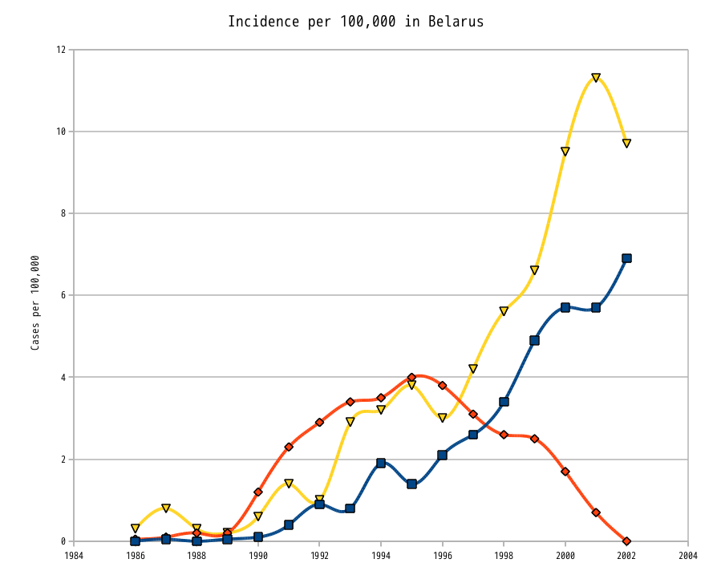
Thyroid cancer Incidence in children and adolescents from Belarus after the Chernobyl accident.
Yellow: Adults (19–34)
Blue: Adolescents (15–18)
Red: Children (0–14)

Slide 16
Nuclear Power Plant Events
Event | Radiation Release/ Risk of Exposure | Long Term Impact
Three Mile Island, 1979 | Limited/low risk of exposure | Fear/stress
Chernobyl, 1986 | Severe/high risk | Cancer/ uninhabitable area
Fukishima, 2011 | High/ high evacuation within 20 km radius amid the destruction and impact of a tsunami | Unknown Health Impacts, Environmental and agricultural impact

Slide 17
TAKE HOME MESSAGE…
When surveillance data are collected, analyzed, interpreted, reported appropriately, these data can provide important information about disease patterns to inform public health practice and policy

Slide 18
Questions?
Acknowledgement: This workshop was sponsored by a grant from the Conference of Radiation Control Program Directors(CRCPD)

