Slide 1
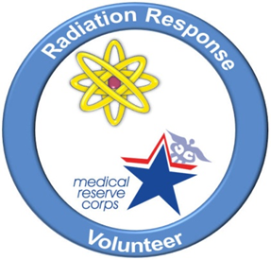
Preparing for Radiation Incidents & Need for Volunteers
Georgia RRVC Hands-On Training Workshop, Nov 16th, 2013
Armin Ansari, PhD
Health Physicist

Slide 2
Topics
The need to prepare for radiation emergencies
Public health response to such emergencies
The need for volunteers

Slide 3
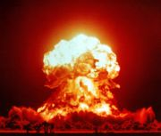
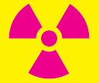
CBRNE (Chemical, Biological, Radiological, Nuclear, Explosive)
A nuclear incident involves a nuclear detonation
A radiological incident does NOT involve a nuclear detonation

Slide 4
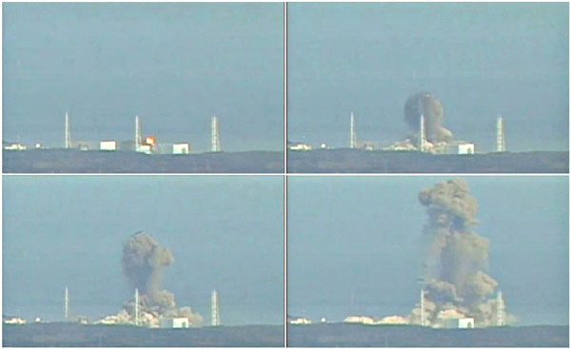
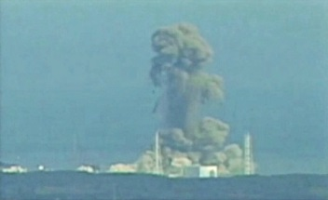
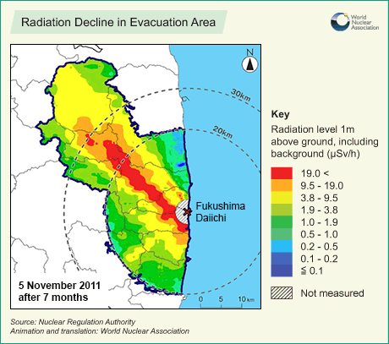
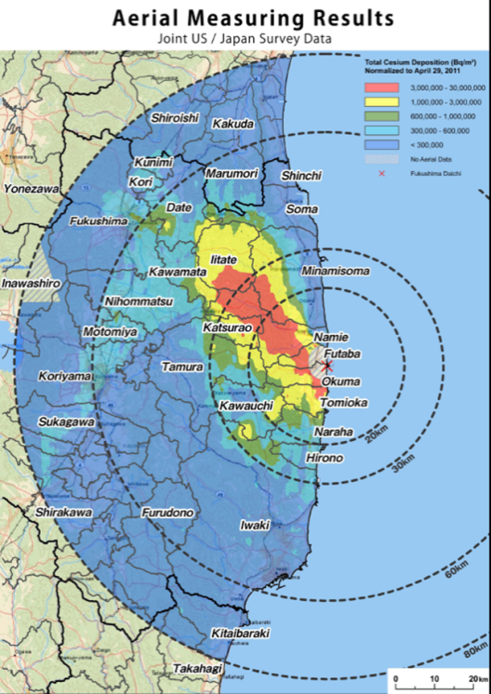
Great East Japan Earthquake 2011
Fukushima Daiichi
170,000 evacuated from the 20-km radius
450,000 people in 2600 evacuation centers
Environmental and agricultural impact
Psychosocial Impact

Slide 5
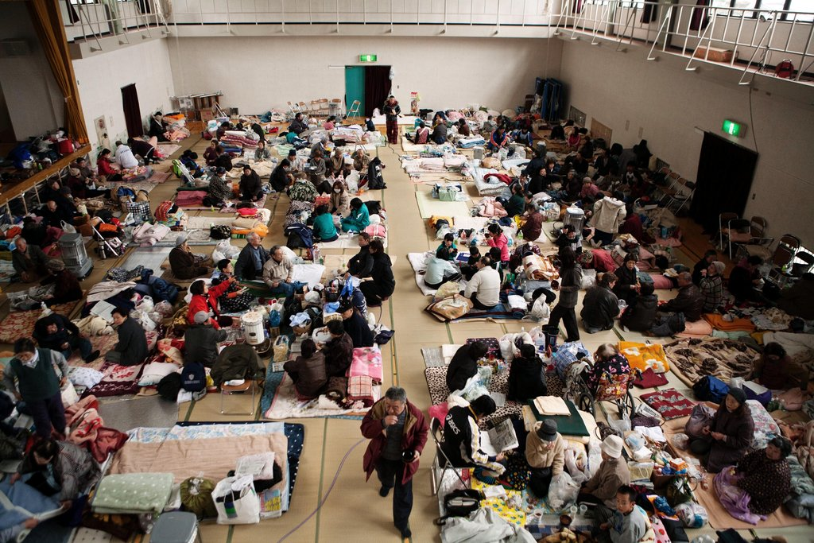
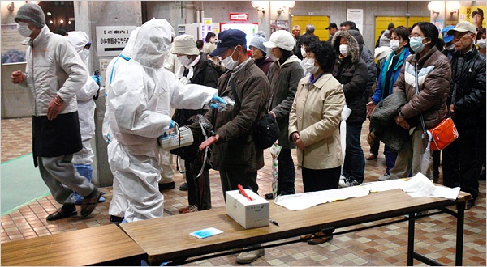
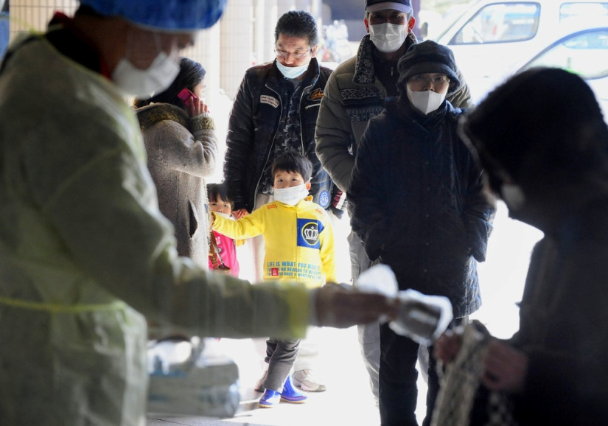
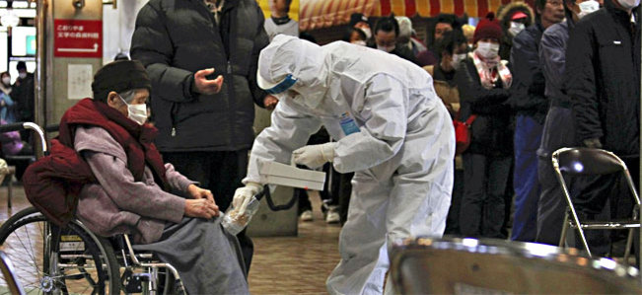
Monitoring at Shelters & Reception Centers Japan 2011

Slide 6
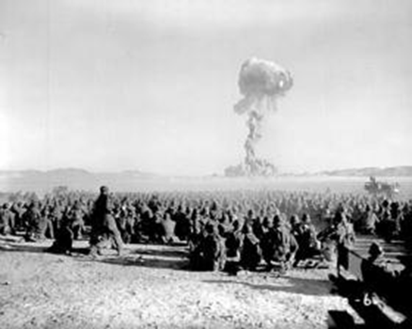
A Nuclear Incident
Improvised Nuclear Device (IND)
Different from Strategic Nuclear Weapon
Example:

Slide 7
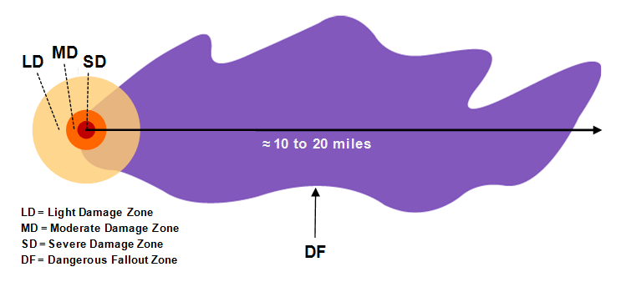
Damage Zones and Fallout Pattern

Slide 8
Public Health Response

Slide 9
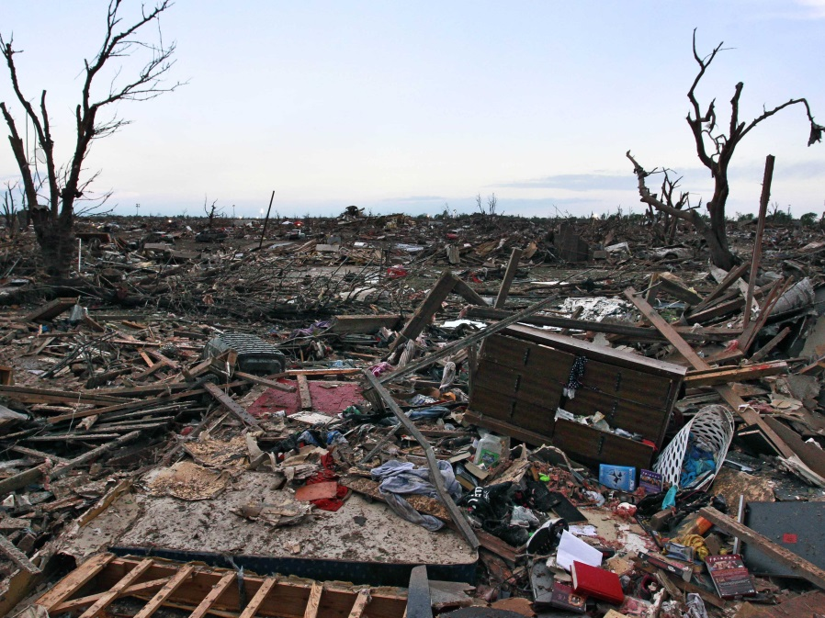
Public Health Functions After Any Disaster
Rapid assessment of health and medical needs
Sheltering and housing, mass care safety
Injury and illness surveillance
Potable water, safe food, sanitation and hygiene
Vector control
Solid waste, waste water management
Hazardous material disposal
Registry
Handling of the deceased
Rumor control
Public service announcements
Notes:
9

Slide 10
Would our community be affected?

Slide 11
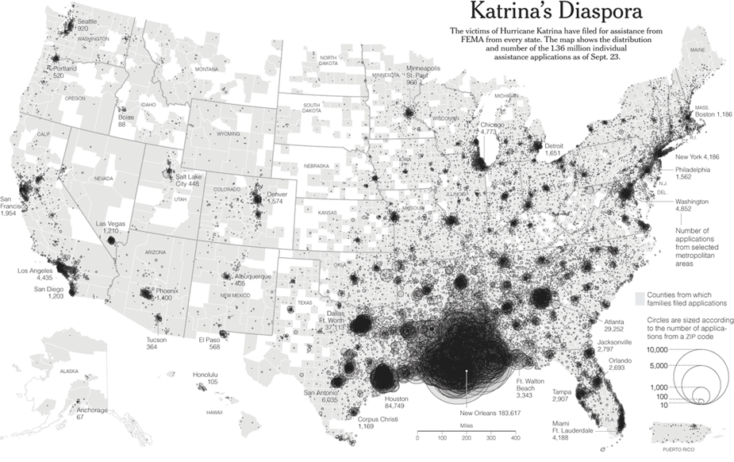
Affected Communities after Hurricane Katrina

Slide 12
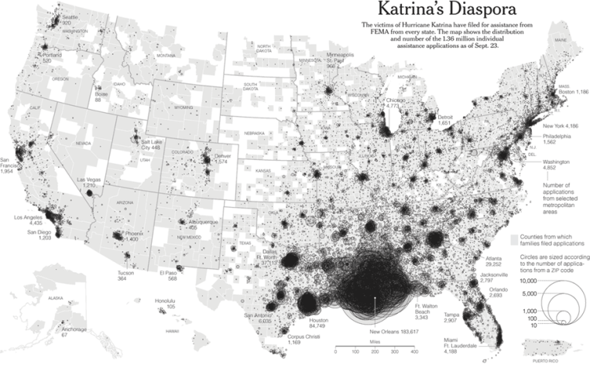
Local Response
Plan to receive a large population
Potential for contamination
Potential for injuries
Some may need immediate medical care
Most may need shelter/temporary housing
All would be stressed

Slide 13
Radiation Incidents Impact on People
Fatality
Injury
Exposure to radiation
Contamination with radioactive material
Anxiety
Displacement
Population Monitoring

Slide 14

National Response Framework Nuclear/Radiological Incident Annex
Decontamination/Population Monitoring are:
“the responsibility of State, local, and tribal governments.”
www.fema.gov/emergency/nrf/

Slide 15
Community Reception Center (CRC)
The place to conduct “population monitoring”
Who will staff them?

Slide 16
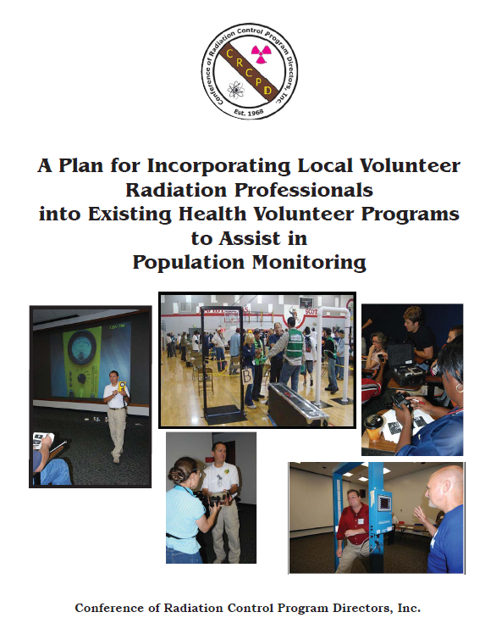

Radiation Response Volunteer Corps
March 2011
CDC, CRCPD, MRC Partnership
www.crcpd.org/Homeland_Security/RRVC_FinalReport.pdf

Slide 17
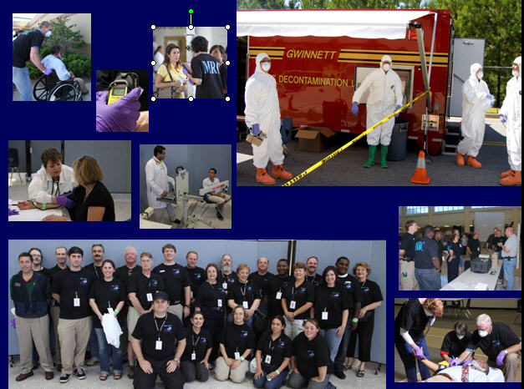
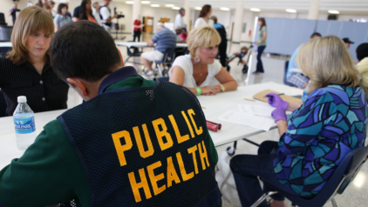
Georgia MRC GEM– July 2009 Peachtree Ridge High School

Slide 18
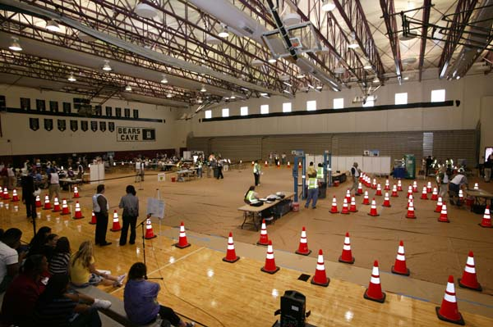
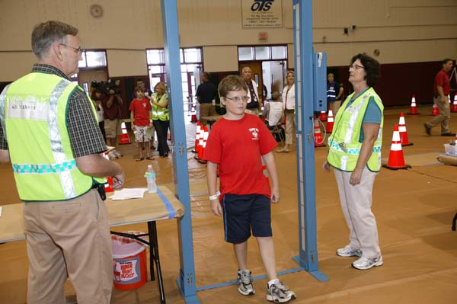
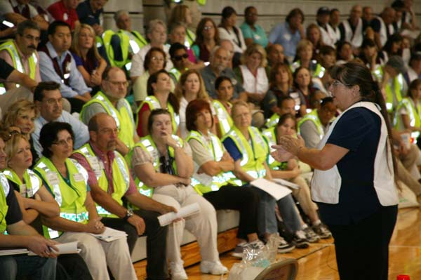
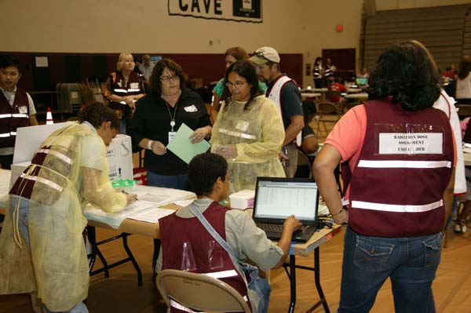
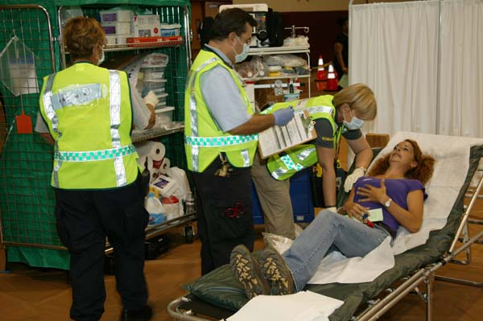
Orlando, Florida CRC - July 2011 Cypress Creek High School

Slide 19
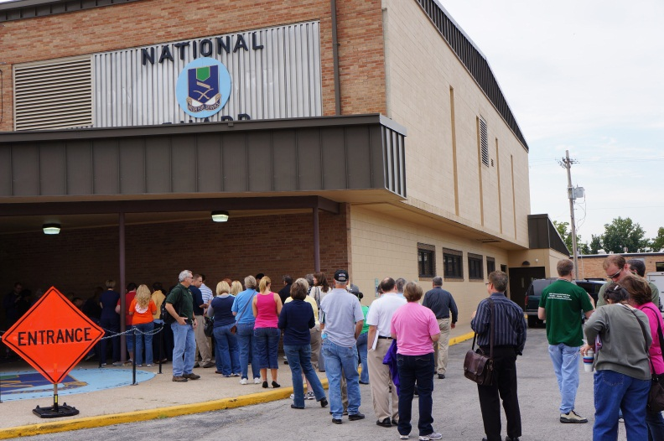
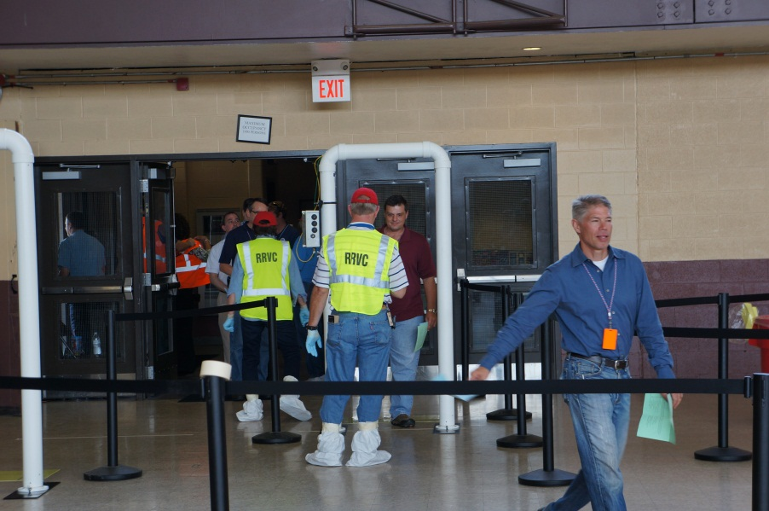
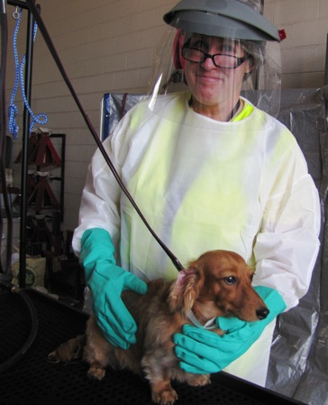
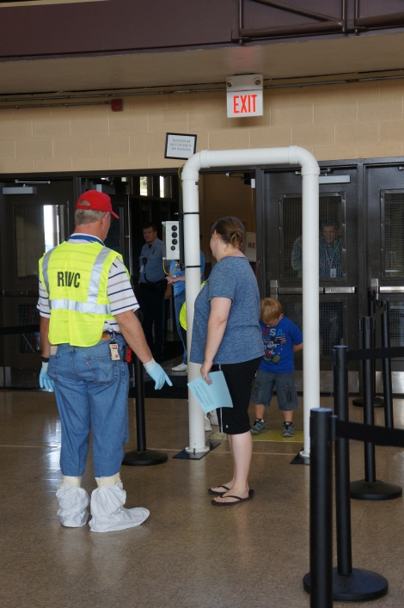
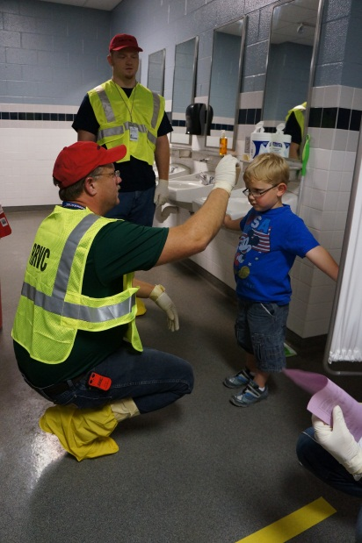
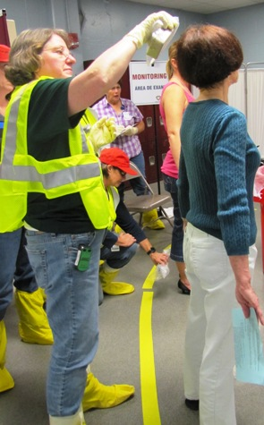
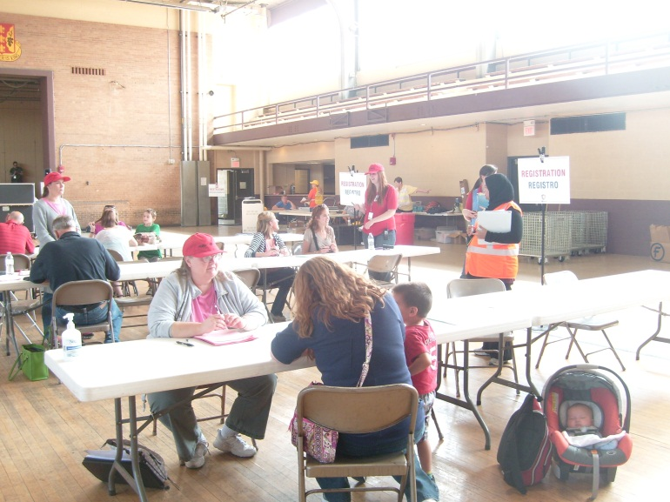
Kansas City, KS - September 2012 Kansas National Guard Armory
Notes:
Amber Waves exercise

Slide 20
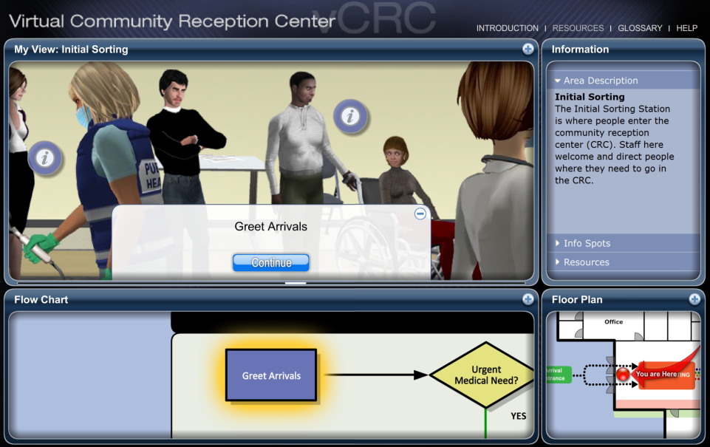
The Virtual Community Reception Center (vCRC)
Web-based training
Animated exploration area
Interactive flow diagram
Embedded video segments
Supporting resources
Job Action Sheets
Forms
customizable for jurisdiction
www.emergency.cdc.gov/radiation/crc/vcrc
Notes:
vCRC is a web-based training program for public health planners, staff, response partners, and organized volunteers. The program features an animated exploration area, an interactive flow diagram, embedded video segments, and supporting resources for CRC operations.
The default view of vCRC consist of four panels, the My View Panel, the Flow Chart Panel, The Floor Plan Panel, and the Information Panel. Panels that have a plus sign in the upper right corner can be expanded to a larger size to facilitate exploration and viewing.
To advance through the vCRC, you answer questions – using either the navigation panel or the flow chart – that correspond to the steps in the CRC flow diagram. There are no right or wrong answers in vCRC. The program is designed to be a free exploration of the virtual CRC. Once you reach an endpoint in vCRC, you can go back to the beginning and explore a different path through the center.
The icons in the My View Panel link to embedded video segments that provide additional information about that particular step in the CRC process.
Now, I’d like to demonstrate vCRC by following a couple different paths through the CRC.
1) Greet Arrivals → Urgent Medical (Y) → Transport Necessary (Y) → Transport to Hospital or Alternate Care Site (END)
2) Greet Arrivals → Urgent Medical (N) → Highly Contaminated (Y) → Shower → Contaminated (N) → Register/Immediate Follow-Up Necessary (Y) → Screen/Assess/Prioritize → Assess for Counseling/Referral Necessary (Y) → Provide Referral for Further Care (END)
3) Greet Arrivals → Urgent Medical (N) → Highly Contaminated (N) → Special Need (Y, Arrange Assistance) → Prior Decon (Y) → Full-Body/Contaminated (N) → Register/Immediate Follow-Up Necessary (N) → Assess for Counseling/Referral Necessary (N) → Discharge to Home or Shelter (END)

Slide 21
Population Monitoring Guidance
http://emergency.cdc.gov/radiation/pdf/population-monitoring-guide.pdf

Slide 22
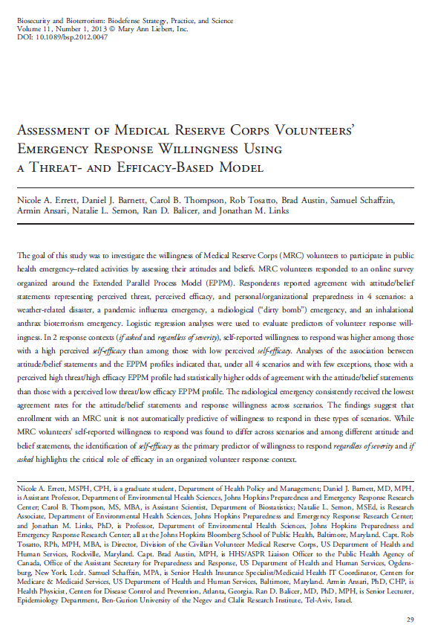
Volunteer Response
“Self-efficacy is the primary predictor of willingness to respond.”
Self-efficacy: perceived ability to perform their volunteer duties
Response efficacy: their perceived impact on combating the given public health threat
Notes:
enrollment with an MRC unit is not automatically predictive of willingness to respond

