Slide 1
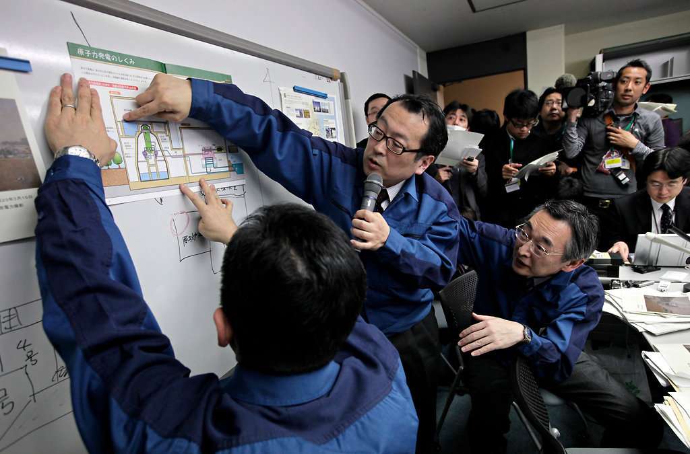
Communication and Psychological Needs in Radiation Emergencies
Leeanna Allen, MPH, MCHES
U.S. Centers for Disease Control and Prevention
National Center for Environmental Health
Division of Environmental Hazards and Health Effects

Slide 2
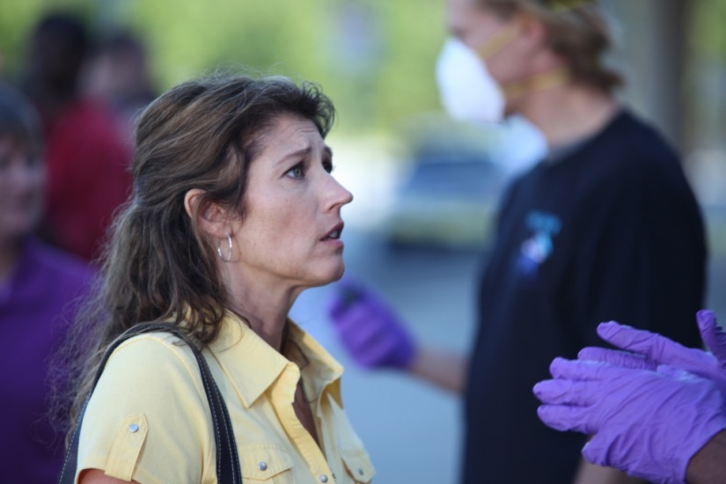
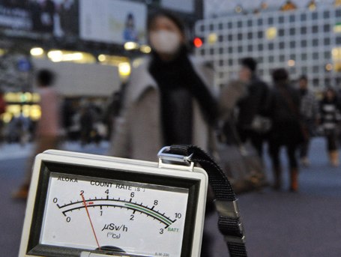
Radiation Disasters are Different
Radiation is:
Invisible
Silent
Odorless
Can only be detected with specialized equipment
Radiation concepts, terms, and risks are poorly understood by the public
Fear
Fatalism

Slide 3
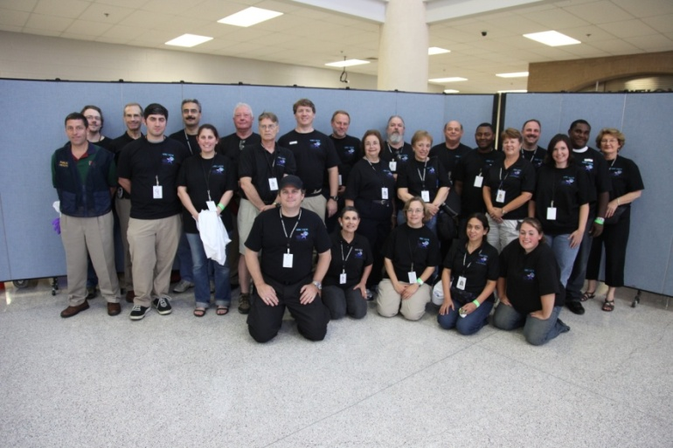
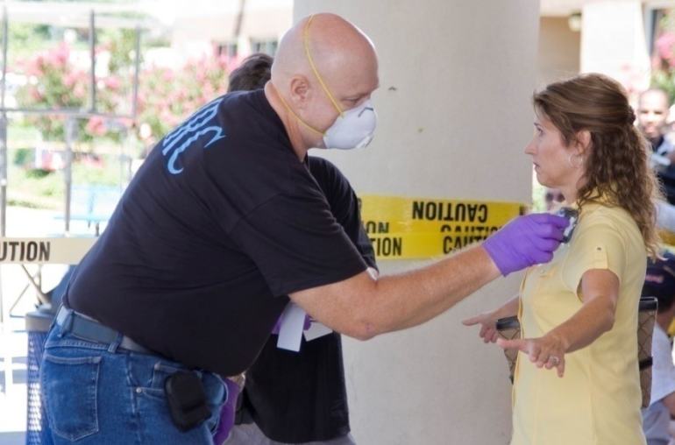
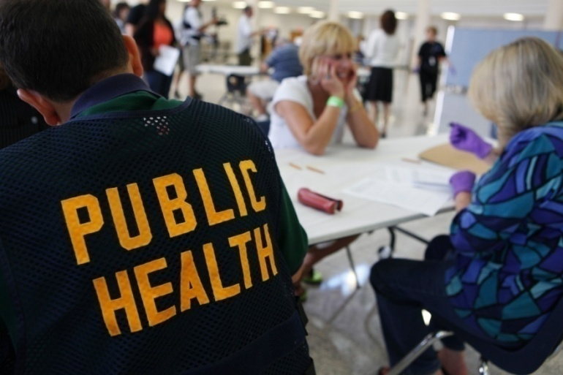
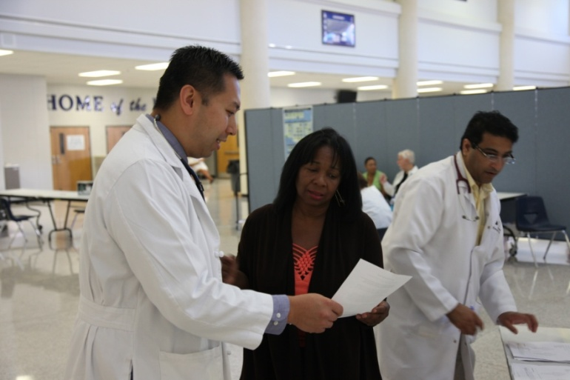
Who may need to administer Psychological First Aid?

Slide 4
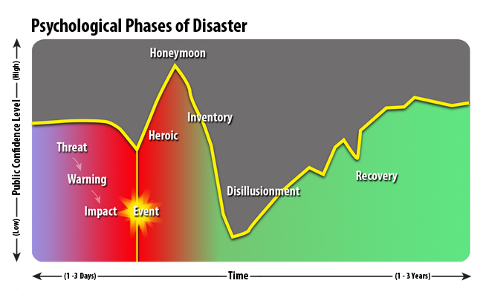

Slide 5
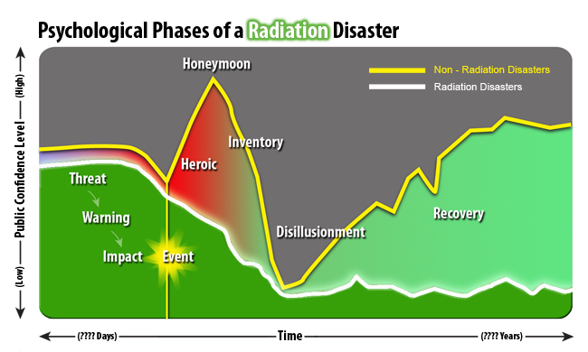

Slide 6
Social Stigma
Can be experienced by those contaminated or potentially contaminated
People may choose not to assist victims of radiation disasters
Lack of social support hinders resilience and recovery efforts
Stigma can also be associated with receiving mental health services

Slide 7
Use Psychological First Aid to Promote:
Safety
Provide repeated, simple, and accurate information on how to meet basic needs
Calm
Speak calmly and be compassionate and friendly
Connectedness
Keep families together
Self-Efficacy
Give practical suggestions to help empower survivors
Help
Direct people to available services

Slide 8
Video: Psychological First aid at the CRC

Slide 9
Communication Goals
Effective communication in radiation emergencies can:
Decrease illness, injury, and death
Facilitate response and recovery efforts
Avoid misallocation of limited resources
Reduce rumors
Minimize medically unnecessary self-referrals to hospitals and other critical facilities

Slide 10
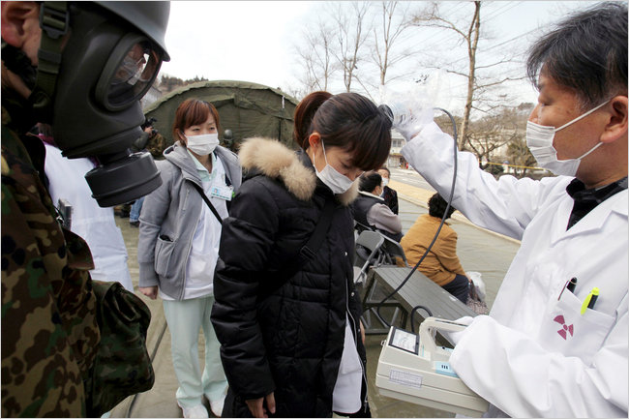

Key Communications Questions
Are we meeting audience needs for information?
How can we bridge the gap between technical information and risk perception?
How can we describe radiation in ways that promote responsible public action?

Slide 11



Radiation Emergency Protective Actions

Slide 12
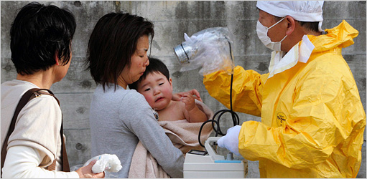
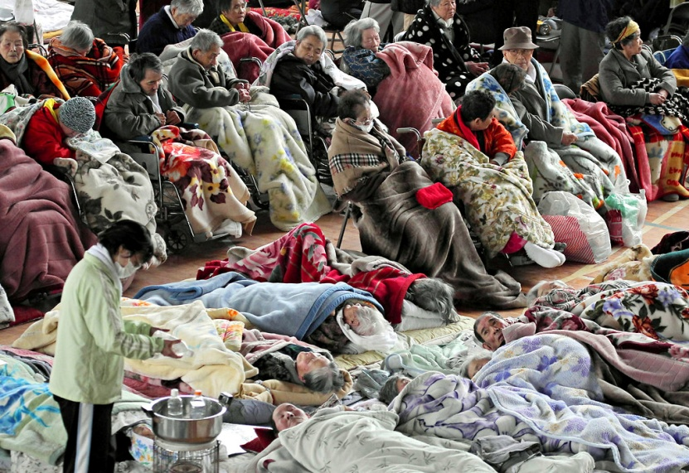
Message Development
Few differences in higher vs. lower education level
Professional responders will have the same concerns as members of the public
Non-English speakers and other special populations will have specific communication needs

Slide 13
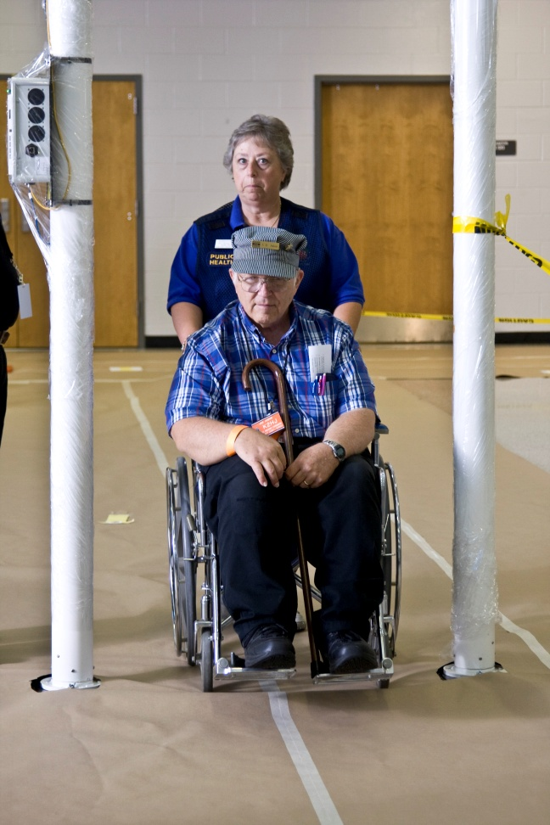
Special Populations
Pregnant Women
Nursing Mothers
Children
Non-English Speakers
Others

Slide 14
Communication Best Practices
Give prioritized action items in each message.
Use plain, non-technical, relatable language
Tailor messages by
Time
Distance
Delivery method
Environment

Slide 15
More Communication Best Practices
Use an urgent and serious tone, but provide a sense of hope
Communicate authoritatively and directly
Make messages concise
Avoid contradictions (real or perceived)
Steer clear of words like “could”, “may”, “might”, “possibly”
Use pictures and visuals when possible

Slide 16
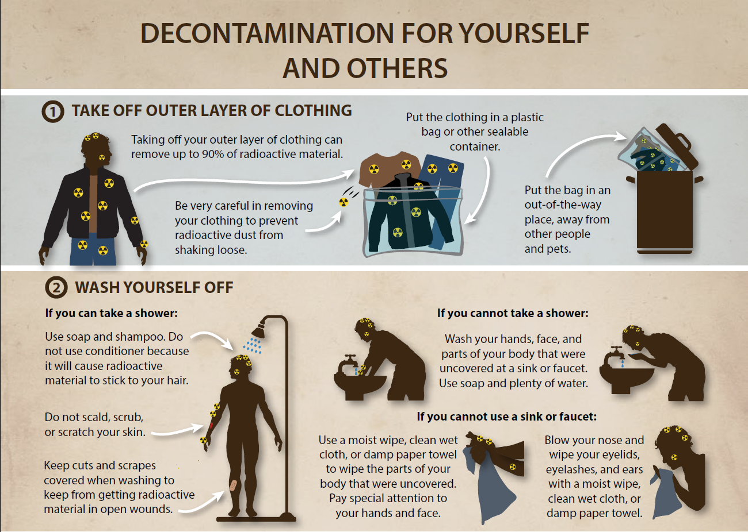

Slide 17
Commonly Misunderstood Terms
Background radiation
Contamination/Contaminant
Detrimental health effects
Dose
Hereditary genetic damage
In the path/Downwind
Internal/external contamination
Low/high radiation levels
Potassium Iodide
Protective actions
Protective measures
Radiation particles
Radiation protection standards and practices
Radioactive material
Rem/Sievert
Responders
Risk of exposure
Sheltering

Slide 18
Sources of Information During an Emergency
People want to hear from radiation scientists
People want a live voice, not a recording
When uncertain, people base their actions on familiar situations, both real and fictional

Slide 19
Resources
CDC Radiation Emergency Communications Research
http://emergency.cdc.gov/radiation/audience.asp
CDC Psychological First Aid in Radiation Disasters
http://www2a.cdc.gov/TCEOnline/registration/detailpag.asp?res_id=2490
Improvised Nuclear Device Response and Recovery: Communicating in the Immediate Aftermath
http://www.fema.gov/media-library/assets/documents/33036?id=7659
Communicating During and After a Nuclear Power Plant Incident
http://www.fema.gov/media-library/assets/documents/33011?id=7651

Slide 20
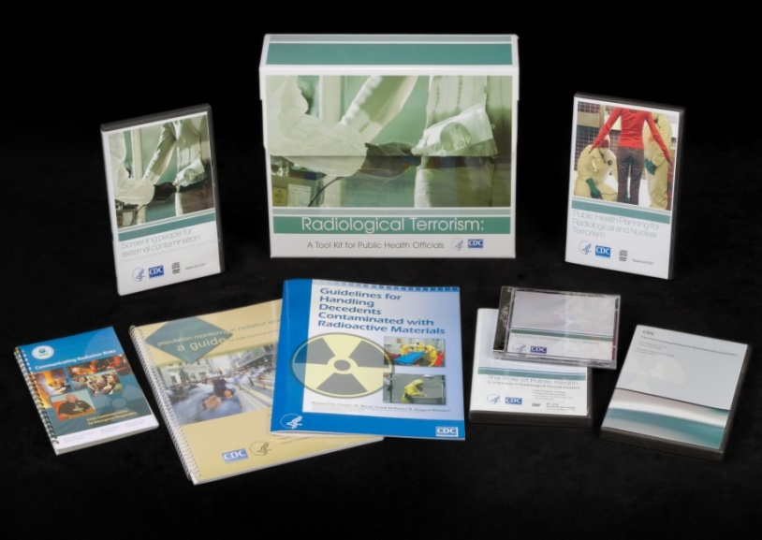
Radiological Terrorism: A Toolkit for Public Health Professionals
Resources for Public Health
Virtual Community Reception Center
Population Monitoring Guide
EPA Risk Communication Guide
Contaminated Decedents Guide
Radiation Survey DVD
Webcasts
Fact Sheets
Psychological First Aid Self-Study

Slide 21

Radiological Terrorism: A Toolkit for Emergency Services Clinicians
Resources for Clinicians:
JIT Training
Pocket Guides
Radiation Triage Chart
Fact Sheets
Webcasts
Self-study Trainings

Slide 22



Do You Know What To Do In a Radiation Emergency?
Visit the newly redesigned site at http://emergency.cdc.gov/radiation

Slide 23
To order complimentary toolkits:
http://emergency.cdc.gov/radiation
Call: 1-800-CDC-INFO (1-800-232-4636);
TTY: (888) 232-6348

Slide 24
Questions?
Leeanna Allen
iei5@cdc.gov
(770) 488-0683
National Center for Environmental Health
Division of Environmental Hazards and Health Effects
Notes:
Thank you so much for your interest and attention to this important topic. I hope that the information provided will be helpful to you in your planning efforts. I’d be happy to take any questions if we have time?

