Slide 1
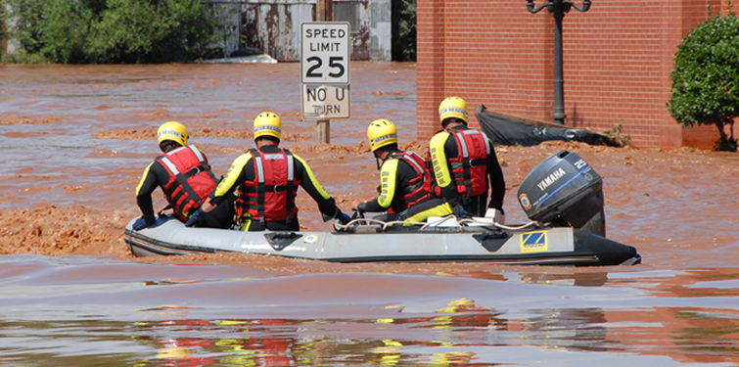
The National Response Framework
An Overview

Slide 2
Topics
NRF background, purpose, key concepts
How the Framework is organized
Applying the NRF
Leadership and the NRF (Federal, State, Local, Private Sector, Nongovernmental Organizations)
Building new capability
2

Slide 3
The National Planning Frameworks…
describe how the whole community works together to achieve the National Preparedness Goal:
  A secure and resilient nation with the capabilities required across the whole community to prevent, protect against, mitigate, respond to, and recover from the threats and hazards that pose the greatest risk.
(http://www.fema.gov/national-planning-frameworks)

Slide 4
MRC GEM’s mission is:
to augment existing community health operations during large-scale emergencies, aid in response to pressing health care needs, and improve community emergency preparedness.

Slide 5
The National Planning Frameworks
There is one Framework for each of the five preparedness mission areas:
National Prevention Framework
National Protection Framework
National Mitigation Framework
National Response Framework
National Disaster Recovery Framework

Slide 6
National Response Framework
Purpose
  Guides how the nation conducts all-hazards incident response
Key Concepts
  Builds on the National Incident Management System (NIMS) with its flexible, scalable, and adaptable coordinating structures
  Aligns key roles and responsibilities across jurisdictions
  Links all levels of government, private sector, and nongovernmental organizations in a unified approach to emergency management
  Always in effect: can be partially or fully implemented
  Coordinates Federal assistance without need for formal trigger
Notes:
Notes
NRF guides how the Nation conducts a national response – not just a Federal response – to all hazard incidents.
Document is focused primarily on response; not on prevention, protection or long term recovery. (More to follow)
Important to understand as we focus on the first word – the NRF as a guide to response.
NRF guides by integrating the first three key concepts:
NIMS is an organizational system of positions, interactions, language and processes that already exists, and is well understood by the emergency management community at the local, state and Federal levels. It describes how first responders from different jurisdictions and disciplines can work together. It is flexible, scalable and adaptable to the size and nature of the incident to organize at the right level – local, then state, then Federal. It is a foundational building block of the NRF.
Better than any predecessor document, the NRF defines and aligns the roles of individual citizens; the private sector; non-governmental organizations; local elected or appointed officials; (the Mayor or city manager with his or her local emergency manager and Department and Agency heads); the Governor with his or her State Homeland Security Manager , State Emergency Manager and Department and Agency heads; with the Federal Government starting with the President and describing the roles of the HSC, NSC, the Secretary of Homeland Security, the Attorney General, the Secretary of Defense, the Secretary of State, the Director of National Intelligence and all other Departments and Agencies. And it describes these roles in a response framework that is always in effect – able to be partially or fully implemented – as the incident requires – and without need for a formal trigger or permission to become involved.
The NRF is not about bureaucracy or rigidity, it is about leaning forward in organized partnership with defined roles and responsibilities to contribute to an effective national response to incidents of all types.

Slide 7
Focused on Response
Achieving a Goal Within a Broader Strategy
Response
  Immediate actions to save lives, protect property and the environment, and meet basic human needs
  Execution of emergency plans and actions to support short-term recovery
National Strategy for Homeland Security – guides, organizes and unifies our National homeland security efforts
  Prevent and disrupt terrorist attacks;
  Protect the American people, our critical infrastructure, and key resources;
  Respond to and recover from incidents that do occur; and
  Continue to strengthen the foundation to ensure our long-term success.
Notes:
Notes
While the NRF’s predecessor was called the National Response Plan, it was actually broadly focused and did not sufficiently address critical incident response issues.
The NRF solves this problem by focusing exclusively on response and short-term recovery and dealing directly with roles, responsibilities, and actions required to achieve effective national response.
The NRF is a key component of the National Strategy for Homeland Security that was issued in October 2007.
Reflects our increased understanding of the threats confronting the US, incorporates lessons learned from exercises and real world catastrophes, and articulates how we should ensure our long-term success by strengthening the homeland security foundation. It reiterates four common goals:
Prevent and disrupt terrorist attacks
Protect the American people and our critical infrastructure and key resources
Respond to and recover from incidents that do occur
Continue to strengthen the foundation to ensure our long-term success.
The NRF, along with NIMS, provide the roadmaps for implementing goal #3.

Slide 8
National Preparedness Goal:
The 14 Response Core Capabilities
Planning (all)
Public Information and Warning (all)
Operational Coordination (all)
Critical Transportation
Environmental Response/Health and Safety
Fatality Management Services
Infrastructure Systems (also Recovery)
(http://www.fema.gov/core-capabilities)

Slide 9
National Preparedness Goal:
The 14 Response Core Capabilities
Mass Care Services
Mass Search and Rescue Operations
On-Scene Security and Protection
Operational Communications
Public and Private Services and Resources
Public Health and Medical Services
Situational Assessment
(http://www.fema.gov/core-capabilities)

Slide 10
National Preparedness Goal: The Other Mission Areas’ 17 Core Capabilities
Forensics and Attribution (Prevention)
Intelligence and Information Sharing (Prevention, Protection)
Interdiction and Disruption (Prevention, Protection)
Screening, Search, and Detection (Prevention, Protection)
Access Control and Identity Verification (Protection)
Cybersecurity (Protection)
Physical Protective Measures (Protection)
Risk Management for Protection Programs and Activities (Protection)
Supply Chain Integrity and Security (Protection)
(http://www.fema.gov/core-capabilities)

Slide 11
National Preparedness Goal: The Other Mission Areas’ 17 Core Capabilities
Community Resilience (Mitigation)
Long-term Vulnerability Reduction (Mitigation)
Risk and Disaster Resilience Assessment (Mitigation)
Threats and Hazard Identification (Mitigation)
Economic Recovery (Recovery)
Health and Social Services (Recovery)
Housing (Recovery)
Natural and Cultural Resources (Recovery)
(http://www.fema.gov/core-capabilities)

Slide 12
CDC’s 15 Public Health Preparedness Capabilities
Community Preparedness
Community Recovery
Emergency Operations Coordination
Emergency Public Information and Warning
Fatality Management
Information Sharing
Mass Care
Medical Countermeasure Dispensing
(http://www.cdc.gov/phpr/capabilities/index.htm)

Slide 13
CDC’s 15 Public Health Preparedness Capabilities
Medical Materiel Management and Distribution
Medical Surge
Non-Pharmaceutical Interventions
Public Health Laboratory Testing
Public Health Surveillance and Epidemiological Investigation
Responder Safety and Health
Volunteer Management
(http://www.cdc.gov/phpr/capabilities/index.htm)

Slide 14
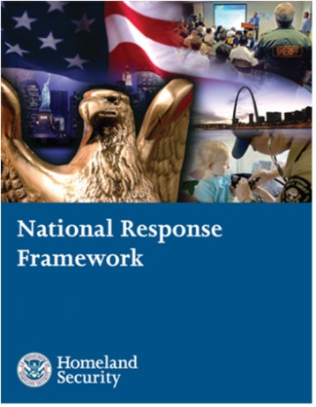
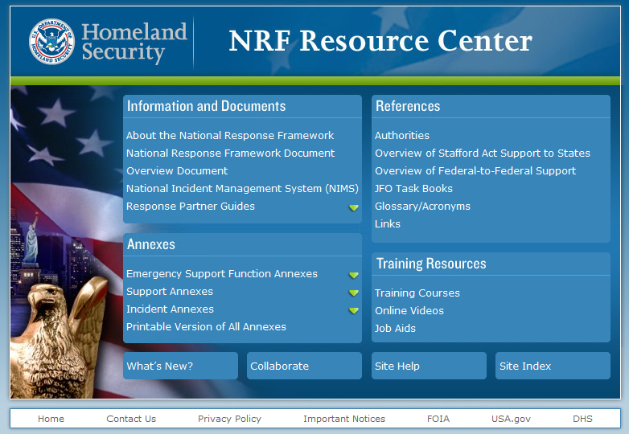
How the Framework is Organized
Doctrine, organization, roles and responsibilities, response actions and planning requirements that guide national response (updated 2013)
Core Document
Emergency Support
Function Annexes
Mechanisms to group and provide Federal resources and capabilities to support State and local responders
Support
Annexes
Essential supporting aspects of the Federal response common to all incidents
Incident
Annexes
Incident-specific applications of the Framework
Partner
Guides
Next level of detail in response actions tailored to the actionable entity
www.fema.gov/nrf
Notes:
Notes
The NRF is composed of two integrated parts: a printed component and an on-line component.
The printed core document: The core document is the heart of the Framework. It describes response doctrine and guidance; roles and responsibilities; primary preparedness and response actions; and core organizational structures and processes. The core document will be reviewed every four years.
The on-line component: The NRF Resource Center (www.fema.gov/nrf), contains supplemental materials including annexes, partner guides, and other supporting documents and learning resources. This information is more dynamic and will change and adapt more frequently as we learn lessons from real world events, incorporate new technologies, and adapt to changes within our organizations.
Emergency Support Functions (ESFs): The 15 ESFs provide a mechanism to bundle Federal resources/capabilities to support Federal, State, tribal, and local responders. Examples of functions include transportation, communications and energy. Each ESF has a coordinator, primary and support agencies that work together to coordinate and deliver the full breadth of Federal capabilities.
Support Annexes: The 8 Support Annexes describe supporting aspects of Federal response common to all incidents: among them are Financial Management, Public Affairs, Volunteer and Donations Management; Private Sector Coordination and Worker Safety and Health. Each Support Annex has a Coordinating Agency and Cooperating Agencies.
Incident Annexes: The 7 Incident Annexes describe how the Framework will be applied in specific types of incidents: among them, Biological, Cyber, Food and Agriculture, Mass Evacuations, Nuclear/Radiological and Terrorism. Each Incident Annex has a Coordinating Agency and Cooperating Agencies. Note that the Incident Annexes are currently being updated and, in the meantime, the existing Incident Annexes to the NRP remain in effect.
Partner Guides: The Partner Guides provide more specific “how to” handbooks tailored specifically to four areas: local governments; State and tribal governments; the Federal government; and the private sector and nongovernmental organizations.

Slide 15
The NRF…
is a Framework … not a Plan
is written for two audiences
    Senior elected and appointed officials
    Emergency Management practitioners
emphasizes roles of the local governments, States, NGOs, individuals and the private sector
establishes Response Doctrine
    Engaged partnership
    Tiered response
    Scalable, flexible, and adaptable operational capabilities
    Unity of effort through unified command
    Readiness to act
establishes planning as a critical element of effective response
Notes:
Notes
‘By its name, format, substance and style, the NRF is an almost radical advancement to its predecessor National Response Plan.
In part, one of the significant changes was that it was written with you in mind – a senior government executive, one who has a responsibility to provide for an effective response – as well as for the emergency management practitioner.
As indicated in its purpose, it guides how the Nation conducts an all-hazard response. Other documents describe how we prevent and how we protect, and a future document will describe how we effect long term recovery. The focus is narrowed to response; includes short term recovery.
And, for the first time, the Framework describes five elements of Response Doctrine:
Engaged Partnerships: Avoid dominoes of sequential failure. Layered, mutually supporting capabilities; plan together; understand strengths / weaknesses, know where gaps are. Develop shared goals; align capabilities so none allows other to be overwhelmed. Oklahoma ice storms: generators
Tiered Response: Incidents must be managed at the lowest possible jurisdictional level and supported by additional response capabilities when needed. California Wildfires
Scalable, Flexible and Adaptable Operational Capabilities: As incidents change in size, scope and complexity, the number, type and source of responses must be able to expand to meet requirements.
Unity of Effort through Unified Command: Effective unified command indispensable to all response activities; requires clear understanding of roles and responsibilities; shared objectives. Each agency maintains its own authority, responsibility and accountability.
Readiness to Act: Readiness to act balanced with an understanding of risk. Requires clear, focused communications. Disciplined processes, procedures, systems. From individuals, families, communities to local, State and Federal agencies, national response depends on instinct and ability to act.
Planning - a critical element of effective response.
We are developing a National Planning System to accompany national exercise system. It will provide common planning focus, format; help build capabilities

Slide 16
Applying the Framework
Most incidents wholly managed locally
  Some require additional support
  Small number require Federal support
  Catastrophic requires significant Federal support
  State Governor must request Federal support
Minor event might be initial phase of larger, rapidly growing threat
  Accelerate assessment and response
  Federal Department/Agency acting on own authority may be initial Federal responder
  Integrated, systematic Federal response intended to occur seamlessly
Notes:
Notes
Key concept is that the NRF is always in effect and operational elements can be partially or fully implemented.
Similar thinking plays out every day in jurisdictions across America where cities, counties and States are employing concepts from the National Incident Management Systems and the National Response Plan.
In most cases, these incidents are managed locally with existing resources. Where a gap in local capability develops, cities and counties have mutual aid agreements with nearby cities and counties to provide additional fire trucks and crews, ambulances and crews, law enforcement and other forms of assistance.
States have a tremendous level of capability with the National Guard and other resources. When a State anticipates a gap, they too have alternatives to coordinate through Emergency Management Assistance Compacts (EMAC) before they request Federal assistance. For example, the State of Florida has a standing EMAC agreement with the State of North Carolina to employ North Carolina National Guard C-130s to evacuate residents from the Florida Keys when threatened by a hurricane.
Only a small number of incidents require Federal support. And, even fewer would be considered catastrophic, where the typical pull of Federal resources from a state would be reversed to initiate a push of resources toward the State.
Yet even in this instance, the Governor must request Federal support. We have developed new policies to encourage Governor’s to make early decisions when they can. This past hurricane season, Texas Governor Perry was the first to request a Pre-Landfall Declaration, that once approved by the President, opened the door to positioning Federal support in HHS medical teams, DoD aircraft; activating a Fed ambulance contract – all in advance of landfall.
It is not always obvious at the outset whether a seemingly minor event might be the initial phase of a larger, rapidly growing threat. The melamine animal food incident or airline passenger with Tuberculosis are examples where a small event, perhaps involving only one department or agency has the potential to grow into a larger, more complex incident.
The Framework provides the coordinating mechanism for sharing information, ensuring rapid assessment and seamlessly integrating Federal support.

Slide 17
Federal Leadership and the Framework
Secretary of Homeland Security: Principal Federal official for domestic incident management
FEMA Administrator: Principal advisor to the President, Secretary of Homeland Security, and Homeland Security Council regarding emergency management.
Principal Federal Official (PFO): Secretary’s primary representative to ensure consistency of Federal support as well as the overall effectiveness of Federal incident management.
  For catastrophic or unusually complex incidents requiring extraordinary coordination
  Interfaces with Federal, State, tribal, and local officials regarding Federal incident management strategy; primary Federal spokesperson for coordinated public communications
Federal Coordinating Officer (FCO): For Stafford Act events, the primary Federal representative to interface with the SCO and other State, tribal, and local response officials to determine most urgent needs and set objectives.
Federal Departments and Agencies: play primary, coordinating, and support roles based on their authorities and resources and the nature of the threat or incident
Note: Consistent with the Post-Katrina Emergency Management Reform Act
Notes:
Notes
The NRF implements the Post-Katrina Emergency Management Reform Act provisions with regard to key Federal incident response leadership positions.
It outlines roles, responsibilities, and interfaces among:
The Secretary of Homeland Security
The FEMA Administrator
The Principal Federal Official
The Federal Coordinating Officer
The NRF also outlines roles of and relationships with and among other key Federal and State leaders.

Slide 18

State & Local Leadership and the Framework
Effective, unified national response requires layered, mutually supporting capabilities
States are sovereign entities, and the Governor has responsibility for public safety and welfare; States are the main players in coordinating resources and capabilities and obtaining support from other States and the Federal government
  Governor
  Homeland Security Advisor
  Director State Emergency Management Agency
  State Coordinating Officer
State & Tribal
Governments
Local
Governments
Local officials have primary responsibility for community preparedness and response
  Elected/Appointed Officials (Mayor)
  Emergency Manager
  Public Safety Officials
Individuals and Households are key starting points for emergency preparedness and support community efforts
NRF
Federal
Government
Private Sector
& NGO
Notes:
Notes
A key concept of the NRF is that effective, unified national response requires layered, mutually supporting capabilities.
The Framework recognizes and builds on the key roles that State and tribal governments plays.
Communities and local jurisdictions are not only the first line of defense when incidents occur, they are also responsible for preparedness and planning efforts.
Successful response begins with effective preparedness by individuals, households, communities, States, and the Federal government.
The Framework emphasizes the role that individuals and households can play in preparing themselves and in supporting community preparedness through initiatives such as Citizens Corps.

Slide 19
Private Sector & NGOs and the Framework
Effective, unified national response requires layered, mutually supporting capabilities
The Private Sector supports community response, organizes business to ensure resiliency, and protects and restores critical infrastructure and commercial activity
NGOs perform vital service missions
  Assist individuals who have special needs
  Coordinate volunteers
  Interface with government response officials at all levels
State & Tribal
Governments
Local
Governments
NRF
Federal
Government
Private Sector
& NGO
Notes:
Notes
The Framework systematically incorporates public-sector agencies at all levels with:
Private-sector organizations (business and industry), and
Nongovernmental organizations that play such key roles in response

Slide 20
The Framework: Building New Capability
Preparedness Cycle–a system that builds the right capabilities
  Introduces National Planning System
  Defines response organization
  Requires training
  Advocates interoperability and typing of equipment
  Emphasizes exercising with broad-based participation
  Describes process for continuous evaluation and improvement
Aligning Risk-Based Planning
  National Planning Scenarios
  Hazard Identification and Risk Analysis
Plan
Organize, Train & Equip
Exercise
Evaluate & Improve
Capability Building
Notes:
Notes
Publishing and implementing the National Response Framework is a key step in the process of improving national incident response.
The steps that will follow are equally key to fulfilling the promise of the NRF.
The cycle consists of:
Synchronizing local, state, tribal, private sector, and NGO plans with the NRF
Organizing, training, and equipping in compliance with pertinent plans
Exercises all key elements and involving all partners
Evaluating what is learned from exercises and actual events
Then starting the cycle again as we enhance our plans based on lessons learned
From a national standpoint, we are committed to institute a National Planning System as mentioned earlier that transforms the legacy Incident Annexes based on a set of National Planning Scenarios and standardized planning protocols and institutionalizing the HIRA approach.

Slide 21

NRF: Equipping Leaders, Practitioners, and Individuals
Improve coordination among Federal, State, local, and tribal organizations to help save lives and protect America's communities by increasing the speed, effectiveness, and efficiency of response.
Notes:
Notes
Vastly improved coordination among Federal, State, tribal, local, private sector, and nongovernmental organizations to help save lives and protect America's communities by increasing the speed, effectiveness, and efficiency of incident management.

Slide 22
Emergency Support Functions / Annexes
ESF #1 - Transportation
ESF #2 - Communications
ESF #3 - Public Works and Engineering
ESF #4 - Firefighting
ESF #5 - Emergency Management
ESF #6 - Mass Care, Emergency Assistance, Housing and Human Services
ESF #7 - Logistics Management and Resource Support
ESF #8 - Public Health and Medical Services
ESF #9 - Search and Rescue
ESF #10 - Oil and Hazardous Materials Response
ESF #11 - Agriculture and Natural Resources
ESF #12 - Energy
ESF #13 - Public Safety and Security
ESF #14 - Long-Term Community Recovery
ESF #15 - External Affairs

Slide 23
Support Annexes
Incident Annexes
Critical Infrastructure and Key Resources
Financial Management
International Coordination
Private Sector Coordination
Public Affairs
Tribal Relations
Volunteer and Donations Management
Worker Safety and Health
Biological Incident
Catastrophic Incident
Cyber Incident
Food and Agriculture Incident
Mass Evacuation Incident
Nuclear/Radiological Incident
Terrorism Incident Law Enforcement and Investigation

Slide 24
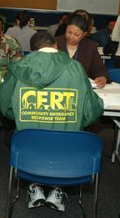

Stakeholder Responsibilities
Individuals and Households: Though not formally part of emergency operations, individuals and households play an important role in the overall emergency management strategy. They can contribute by reducing hazards in and around their homes, preparing emergency supply kits and household emergency plans, and monitoring emergency communications carefully.
Local Government: Responsibility for responding to incidents begins at the local level with individuals and public officials in the county, city, or town affected by the incident. Local officials are responsible for ensuring public safety and welfare of people of that jurisdiction. The local emergency manager has the day-to-day authority and responsibility for overseeing emergency management programs and activities.
Notes:
Note
Effective response to an incident is a shared responsibility of governments at all levels, the private sector, NGO, and individual citizens.
Communities, tribes, States, the Federal Government, NGOs, and the private sector should each understand their respective roles and responsibilities, and complement each other in achieving shared goals.
It is important that each level of government adapt and apply the general roles outlined in the Framework.
Stakeholders can support and implement the NRF through the following actions:
- Define key leadership and staff functions
- Adopt capabilities-based planning as the method to build response capabilities
- Conduct collaborative planning
- Participate in training and exercises
Due to statutory limitations, the NRF cannot mandate non-Federal entities to comply with the NRF and its principles, but full cooperation is encouraged by these partners.

Slide 25

Stakeholder Responsibilities
States and Tribal Governments: A primary role of State government is to supplement and facilitate local efforts before, during, and after incidents. Governors, State homeland security advisors, State emergency management directors, and tribal leaders have key roles and responsibilities for incident management.
Private Sector: In many facets of an incident, the government works with private sector groups as partners in emergency management. Many private sector organizations operate and maintain major portions of the critical infrastructure.
Nongovernmental Organizations: NGOs play an enormous role in emergency management before, during and after an incident. For example, NGOs provide sheltering, emergency food supplies, counseling, and other vital services to support response and promote the recovery of disaster victims.
Notes:
Notes
DHS and all other Ds/As can achieve the objectives of HSPD-5 by focusing in three key areas:
First, by understanding key concepts we’ve discussed, but obviously in more detail. The core document is written such that Secretaries, Deputies and Assistant Secretaries can be familiar and take a leading role to ensure alignment and integration between and among departments and agencies.
Second, by focusing persistently on attaining a high level of preparedness:
Plan collaboratively – We do not currently plan as well as we should. You can support new National Planning System that will require reallocation of resources this FY to develop plans against the national planning scenarios, strategic guidance, strategic plan; contingency plan and operations plans
Organize to execute an effective response consistent w/NRF structures; train on its concepts in Washington and in the field
Ensure sufficient equipment is in place to meet response requirements, where possible bundling into standardized caches, ensuring that it is serviceable and ready for deployment.
Participate in Nat’l Exercise System, including documenting and applying lessons learned
These five steps are needed to define / build right capabilities appropriate to threats we expect to confront.
Third, taking every practical step to execute an effective response
Situational Awareness will challenge Ds/As to improve and integrate national reporting; to connect operations centers and tap into subject matter experts.
Taking steps to attain greater coord in activating and deploying capabilities; pre-scripted mission assignments, working group to improve mission assign process; staffing Joint Field Office;
Coordinating Response actions through FEMA NRCC; Region working w/State, National & international
Demobilize in orderly manner – coordinating with FEMA and State (CA Wildfires)

Slide 26
Federal Department & Agency Responsibilities
Understand Key Framework Concepts
  Structure, organization, roles and responsibilities
Attain High Level of Preparedness
  Plan
  Organize
  Equip and Train
  Exercise
  Evaluate/Improve
  Build Capabilities
Execute an Effective Response
  Gain and maintain situational awareness
  Activate and deploy resources and capabilities
  Coordinate response actions
  Demobilize
“The effectiveness of our efforts will be determined by the people who fulfill key roles and how they carry out their responsibilities, including their commitment to develop plans and partnerships, conduct joint training and exercises, and achieve shared goals.”
National Strategy for Homeland Security
Notes:
Notes
The NRF applies to all Federal departments and agencies that may be requested to provide assistance or conduct operations during incidents requiring a coordinated Federal response.
Federal departments and agencies should:
Ensure that their incident responders as well as their leaders are familiar with the document.
Provide cooperation, resources and support to implement the NRF as appropriate, consistent with their own authorities;
Designate representatives to staff the NRF coordinating mechanisms such as the Joint Field Office or National Response Coordination Center;
Carry out responsibilities assigned in the ESFs, Support and Incident Annexes;
Coordinate operations at the Headquarters and Field level through structures outlined in the NRF;
Conduct collaborative planning;
Share Information in real time between their operation centers and the DHS National Operation Center; and
Exercise and Train together through the National Exercise System.

Slide 27
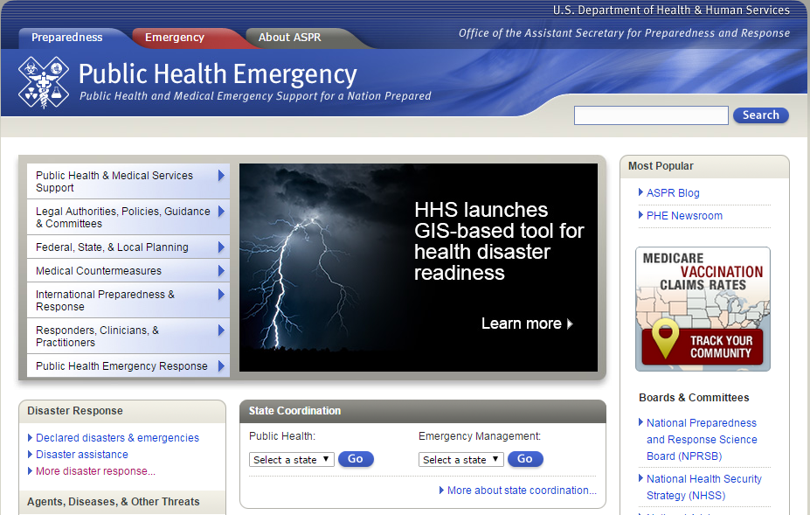
http://www.phe.gov/preparedness/Pages/default.aspx

Slide 28
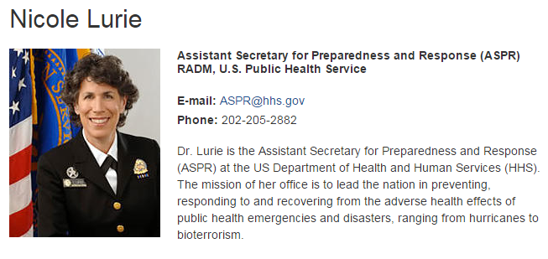

Slide 29
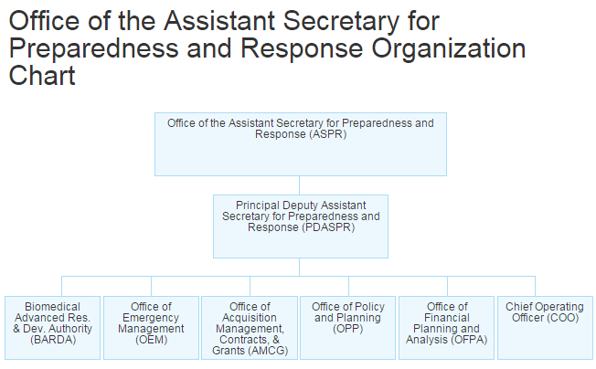

Slide 30
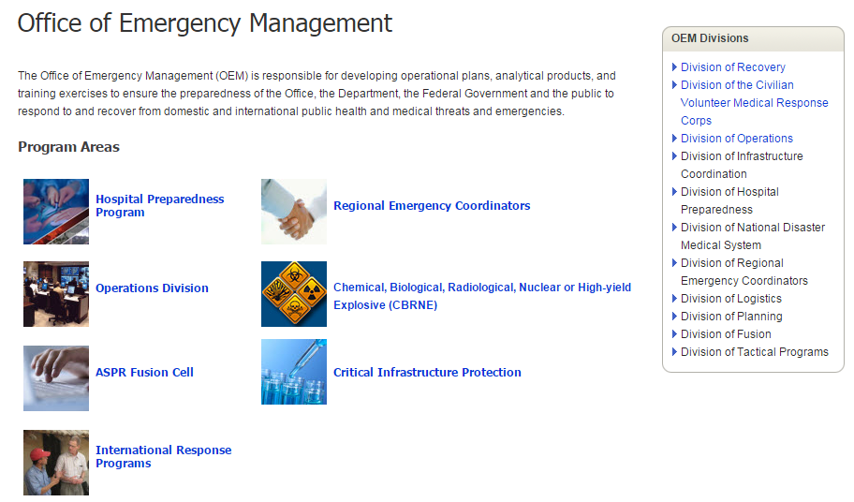

Slide 31
Questions?
A copy of this presentation (and many others) is available on our web site, http://mrcgem.com, at the “Reference” tab.

