Slide 1
SAR
Overview of Search and Rescue
for the Volunteer
MRC GEM
July 15, 2017
Mona Hand

Slide 2
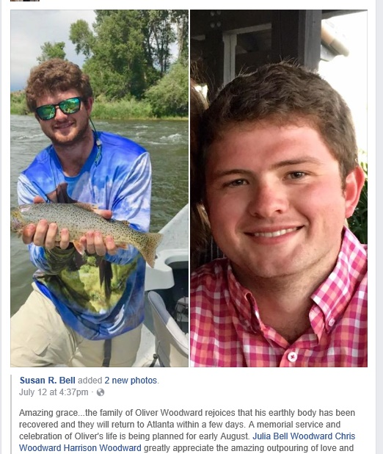
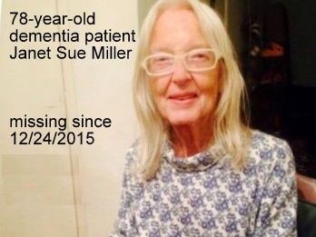
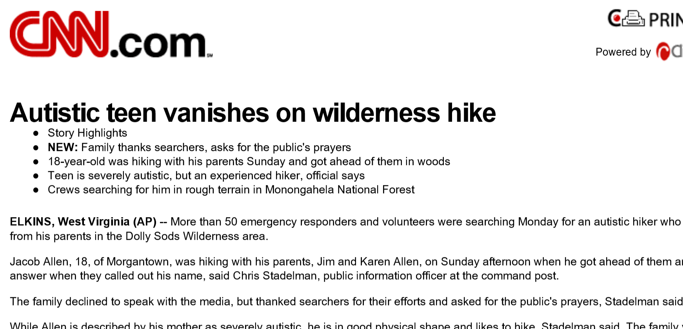
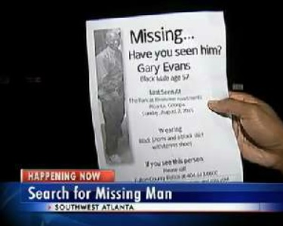
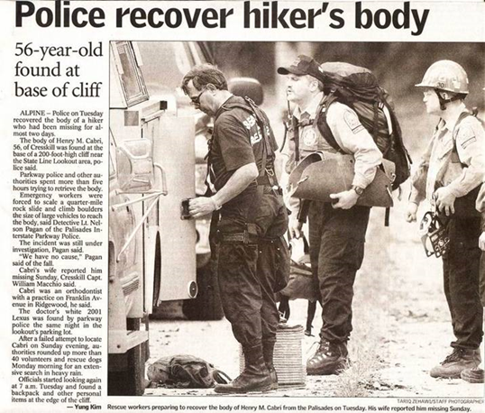
Search and Rescue
That others may live
More people are missing
than you realize
Closure for families

Slide 3
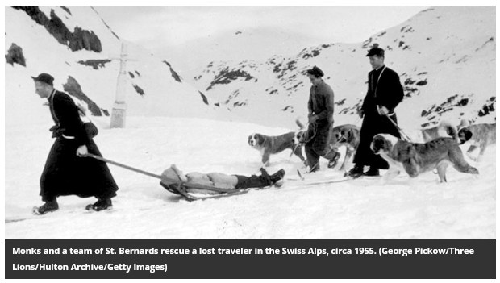
St. Bernard Hospice trained St. Bernard Dogs to perform search and rescue with monks - 1600s.
Over a span of nearly 200 years, about 2,000 people, from lost children to Napoleon's soldiers, were rescued because of the heroic dogs' uncanny sense of direction and resistance to cold.
http://www.smithsonianmag.com/travel/a-brief-history-of-the-st-bernard-rescue-dog-13787665/#wwqemFI9LhYOT4oS.99

Slide 4
Duty to all travelers
When a monk was killed trying to guide a group of smugglers…. Asked why smugglers and criminals were freely helped by the monks, one replied,
  “Our duty is to all travelers. Why they are traveling is not our concern.”
This lack of judgement about the motives of those in trouble continues in SAR teams today.
Tim J. Setnicka, Wilderness Search and Rescue

Slide 5
L.A.S.T.
Components of Search and Rescue
Locate – Search
Access
Stabilize
Transport
Today we are discussing the Locate/Search segment.

Slide 6
Pre-Planning and Preparation
Training
Pre-plans
Equipment
Mitigation
  Georgia Appalachian Trail Club – SAR
    Get out on the trail and look for confusing markers or areas that need attention to prevent incidents
  “Hug-A-Tree” program (NASAR) – demonstrates what youth should do if they get lost

Slide 7
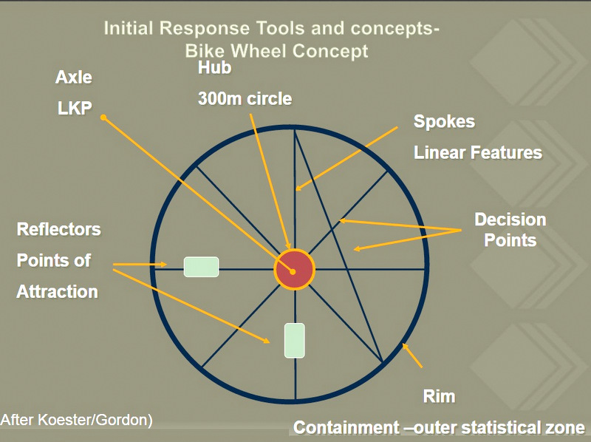
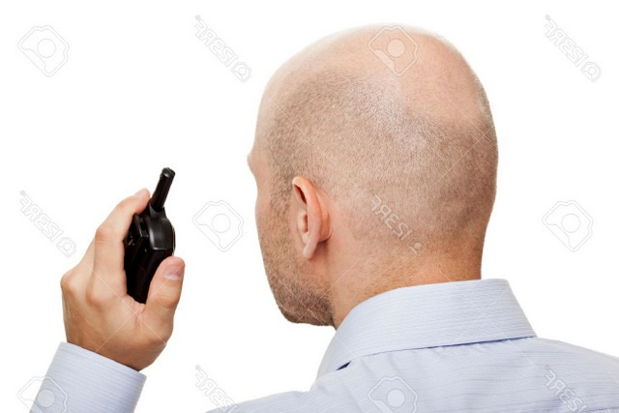
Evolving Incident
Reflex Tasking
  Containment, Strike Teams
Resources – What do I have and need?
  Specialized resources – dogs, trackers, etc.
Tactics – lost person behavior, search management techniques
Communications
  Medium, Convention, Hierarchy
Management/Command Post – NIMS/ICS

Slide 8
Search dogs as search aids are important, too!
Nose is thousands of times more receptive than a human
Tracking/Trailing and Scent
Imperative to protect scent articles and NOT interfere with scent tracks, depending on dog
Avoid vehicles or trucks left running or passing through grid areas.
Never precede search dogs if possible

Slide 9
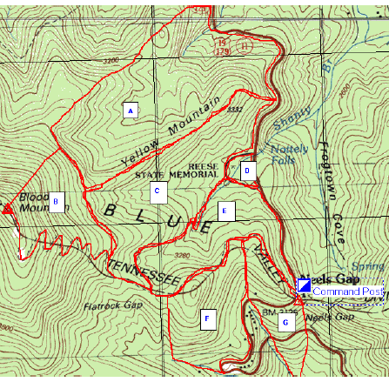
Incident/Search Planning
Containment
Probability of Area
Prioritize
Probability of Detection
Lost Person Behavior

Slide 10
So, how can you help?
SAR
Track
Skills
Skills – NASAR, team training, land navigation, communications
Credentials = give you a “known quantity”
Join a team
If you want to go out in the field, you need to be serious about your conditioning / physical fitness
Gear
Maps
Drills
PACK
Priorities
SIGN

Slide 11
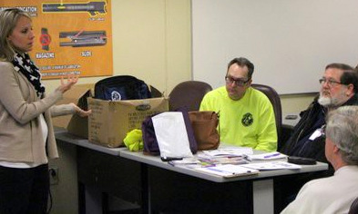
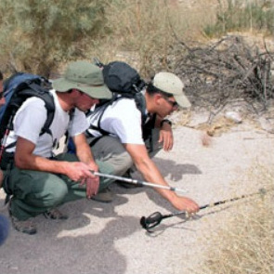
Skills from Training
Search and Move
Be Observant
Use tools and technology
Deal with challenging conditions while keeping your observational abilities
Communicate and Collaborate
Less likely to destroy clues
Night searches

Slide 12
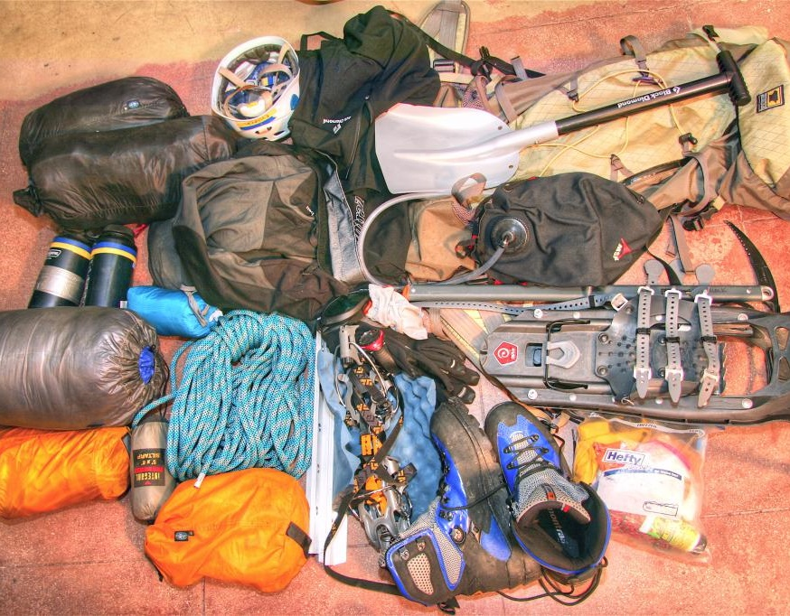
Equipment
Functional comfort
“Emergent resources” are not equipped or prepared to search at night/inclement weather / difficult terrain
Searchers don’t have time to round up supplies
Each Team has a different equipment list and can change according to operation or weather

Slide 13
SAR Teams and Resources

Slide 14
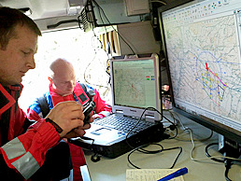
Lost Person Behavior by Robert Koester
Statistical analysis of results from many kinds of searches over many years
Guides searchers to subjects' most likely location based on numerous factors
Considerations
subject's age, gender, mental/physical state
dementias such as Alzheimer’s
sensory deficiency such as Deafness, Autism
scene's geography, topography, weather, traffic, ...;
incident's time, ecoregion, elevation, spacial features, detection medium, proximity distance, circumstances, ...
lost, overdue, sick/hurt, evasion/criminal , emergency
Lecture at Radcliffe, Harvard
Expedient discovery relies on prompt investigation.

Slide 15


National Association of Search and Rescue
http://www.nasar.org/

Slide 16
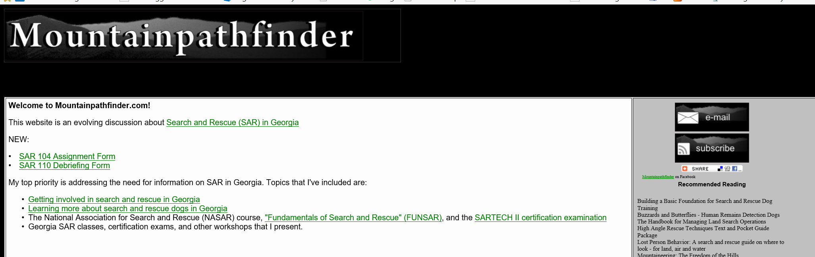
Mountain Pathfinder
http://www.mountainpathfinder.com/georgia_search_and_rescue.html
Great resource for information and training opportunities specific to Georgia

Slide 17
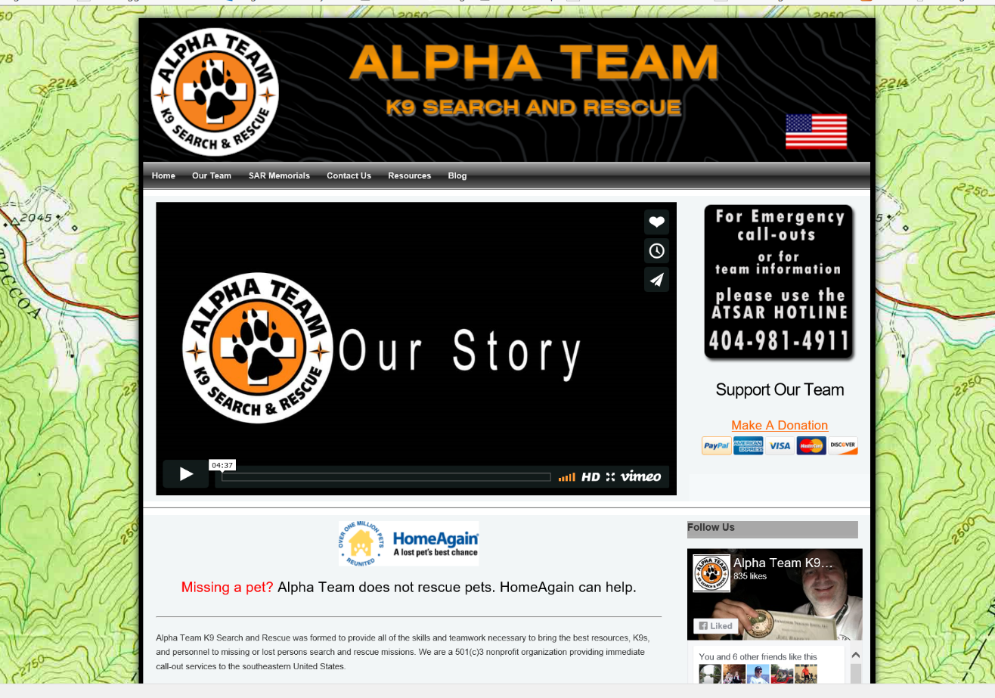
Alpha Team
http://www.atsar.org/

Slide 18
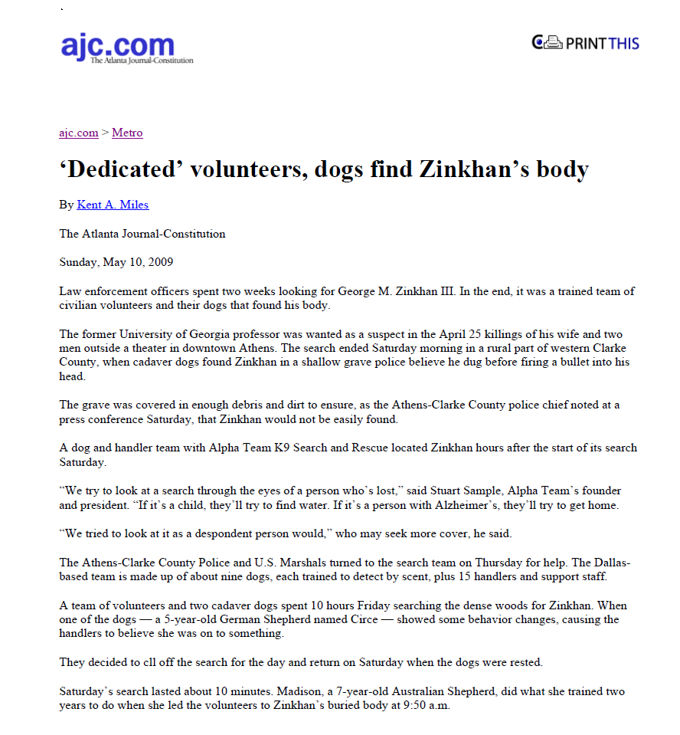
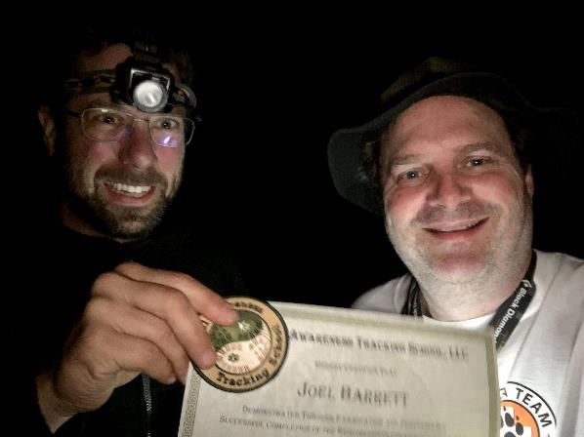
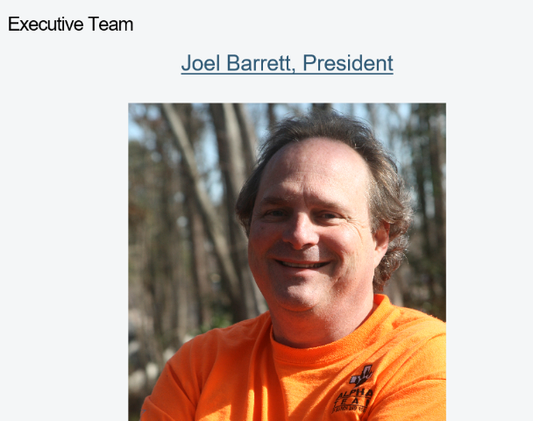
Alpha Team

Slide 19
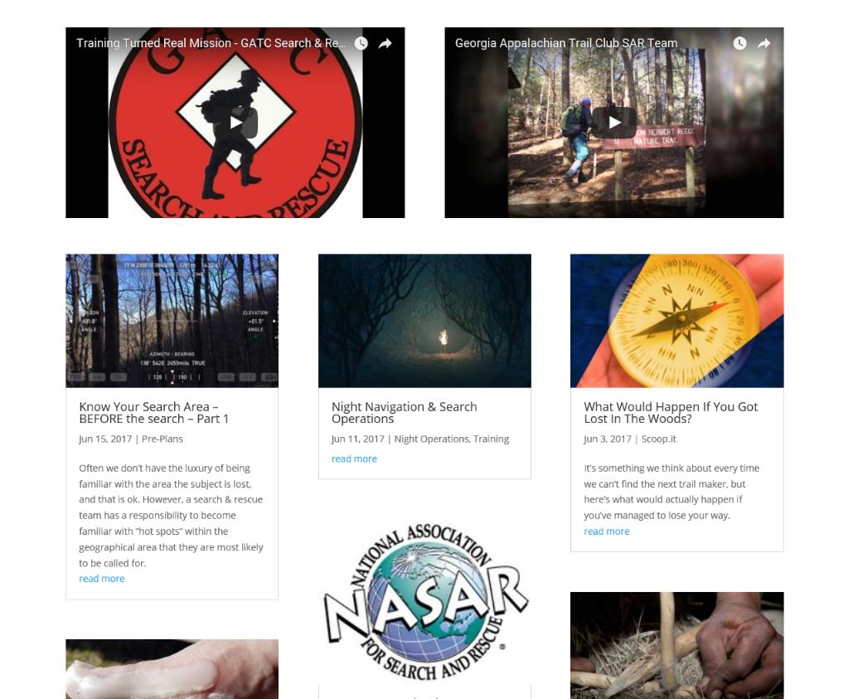
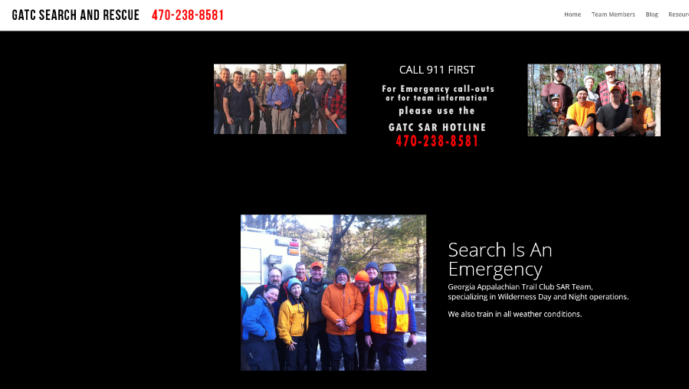
Georgia Appalachian Trail Club
SAR team
http://georgiasar.com/

Slide 20
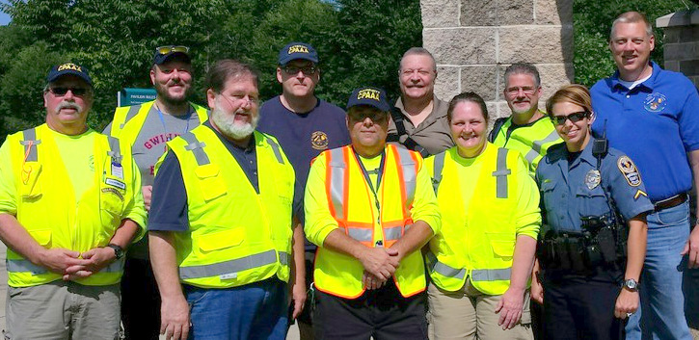
Gwinnett Police Academy Alumni Association
SAR Team - 2016
www.gwinnettcpa.com/
• Angel Alonso
• Bill Black
• Brett Gordon
• Frank Stubits
• Jane Drake
• John Clark
• Larry Cavener
• Mike Stebnicki
• R Michael Carter

Slide 21
Tracking
What is it?

Slide 22
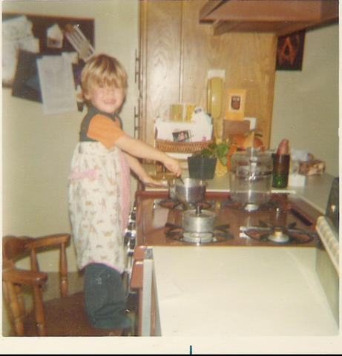
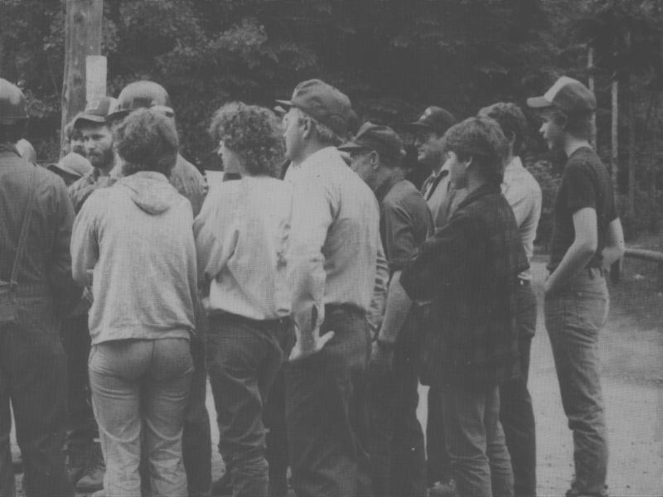
Why? …that others may live.
Jimmy Beveridge
Andy Warburton
And all like them…..
Notes:
Although no more than a few words at a time may have been directly pulled from any published source, this presentation is definitely a compilation of thoughts and print written by others with vast knowledge in this field. Normal citations are omitted and this broad thank you is provided because this is intended for our own internal team training where presenters have direct access to these copyrighted materials, and no commercial benefit of any kind will be solicited in anyway.

Slide 23
Jimmy
Jimmy Beveridge’s mother posted a message in February 2008 regarding her son who was lost in 1981 and became the impetus for the “Hug A Tree” program (started by a well known tracker, Ab Taylor).
"Jimmy was born March 10, 1971. He died February 11, 1981 (a month before his 10th birthday).
He was a very bright, active, mischievous child. After his death, his 2nd grade teacher shared that she had once asked him for his autograph because she knew he would one day be famous.
At the age of nine his Dad was teaching him to play chess and after two lessons he was already a challenge!
We may from time to time share snipits of his life with you. It certainly helps keep his memory alive. We're sure that he smiles everytime a Hug-A-Tree program is presented knowing that others will know what to do to be found safe.
Blessings,
Larry and Jacquie Beveridge"
Notes:
Although no more than a few words at a time may have been directly pulled from any published source, this presentation is definitely a compilation of thoughts and print written by others with vast knowledge in this field. Normal citations are omitted and this broad thank you is provided because this is intended for our own internal team training where presenters have direct access to these copyrighted materials, and no commercial benefit of any kind will be solicited in anyway.

Slide 24
Andy
The Andy Warburton Story - In the summer of 1986, nine-year old Andrew Warburton, became lost in the woods outside Halifax.
Within hours a search was begun for young Andy that would come to include more than 5,000 volunteers combing the woods, making it the largest ground search in Canadian history.
Despite a large scale effort, his discovery was too late and young Andy Warburton died in the woods, even though a rogue tracking team found prints and a sign line and urged leaders to focus in the very area he was eventually found in, days earlier.
Notes:
Although no more than a few words at a time may have been directly pulled from any published source, this presentation is definitely a compilation of thoughts and print written by others with vast knowledge in this field. Normal citations are omitted and this broad thank you is provided because this is intended for our own internal team training where presenters have direct access to these copyrighted materials, and no commercial benefit of any kind will be solicited in anyway.

Slide 25
Trackers follow visual evidence
As you will come to realize through this presentation, there is a nearly continuous connection of sign that connects the lost person directly to the last known position.
Skilled tracking teams can reduce effort and reduce the time to find a subject.
Notes:
Although no more than a few words at a time may have been directly pulled from any published source, this presentation is definitely a compilation of thoughts and print written by others with vast knowledge in this field. Normal citations are omitted and this broad thank you is provided because this is intended for our own internal team training where presenters have direct access to these copyrighted materials, and no commercial benefit of any kind will be solicited in anyway.

Slide 26
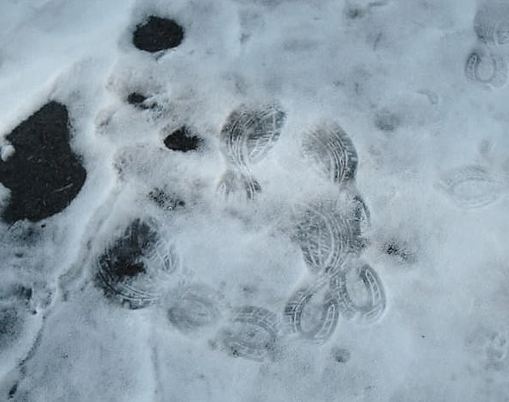
BECOMING TRACK AWARE
Notes:
If nothing else is gained, participants should understand what tracking is, how it works, what to look for and how to avoid damaging sign and clues that could be key to a successful search.

Slide 27
What is Clue and Track Awareness?
Techniques to help you be a better searcher
Education and PRACTICE in finding the sign that lead all the way to the lost person
A commitment not to destroy clues that could save someone’s life!
  It is very unfortunate that well-intending family, friends or even law enforcement may destroy clues unknowingly, but it is virtually a crime for a trained searcher to destroy sign!

Slide 28
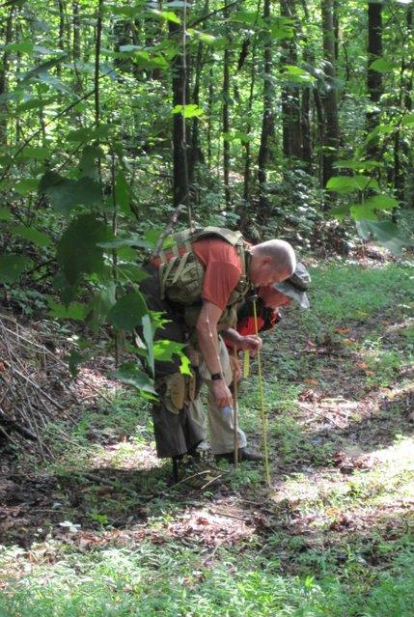
Tracking is a Search Tool
Definition: Following continuous chain of sign that
indicates the route of an animal or person
Tracking focuses search efforts
and increases search efficiency
It is only ONE of many tools that
are used to reach the search objective,
which is a live subject
Finding sign and reading all sign accurately is the
goal for any tracker
DNR used Tracking in the 2004 Will Carter search where Will’s dog was successfully tracked back through the mountains to where it had slept through the night, just a few hundred yards from where Will was found.
Notes:
- More definitions and greater details are contained in subsequent slides.
Other tools that may be considered are helicopters, dog teams, attraction fires and sirens, confinement, mounted teams or ATV teams, etc…
One caveat with tracking is that once a track is destroyed, it can’t be reconstituted and therefore, a very thorough cutting operation is required to ensure the first sign is found the track is identified. Patience and thoroughness by the tracking team and the Search overhead team is necessary for success.
Other activities can begin, including all planning and callout activities, hasty team, confinement, etc… so giving a tracking team time to work is not a significant cost.

Slide 29
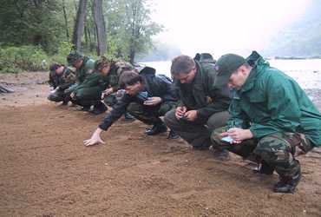
First Step: Become track aware
What are we looking for?
  A lost person?
  Shoe Prints?
NO!
  We are looking for CLUES!
Well defined tracks at the PLS are
important first clues that can substantiate a search.
A properly conducted search incident will have trained trackers on the ground at the earliest stage of the search.
Notes:
The most informed search leaders desire quick interview details and a quick view of the PLS. The best search leaders will perform these tasks WITHOUT disrupting the track evidence.
Tracking teams should be called out or formed up as soon as a Search overhead team is being formed.
Everyone is responsible and must ensure that clues are NOT destroyed and help ensure others adhere to this rule as well.

Slide 30
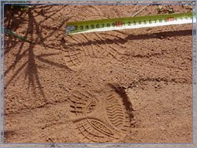
Being track aware preserves evidence
So…what does tracking tell us??
At a minimum, tracking should be used to detect the direction of travel (DOT) or estimated bearing that someone or something is moving.
…and other important information
Notes:
Establishing a DOT provides a significant reduction to the overall work effort (detailed in a slide later).
Other important information may be as basic as how many people are traveling together or as complex as whether they are unaware they are lost, hurried, in a panic, trying to avoid detection or hurt.

Slide 31
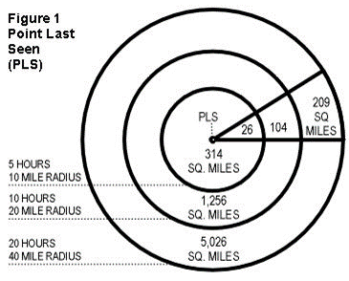
D.O.T can reduce work load by man days of work or more
Estimates for Lost hiker, 5 Hours overdue.
  10 miles in any direction
  314 square miles // reduced to 26 square miles
  520 Searchers // reduced to 170 searchers
  5 days // reduced to 1 day
  TRACKING IS WORTH THE EFFORT
Notes:
Reducing enormous search efforts to manageable levels is a key to success.
Some search areas may be eliminated altogether, once a DOT is established.
Tracking can be used throughout the search and anytime new clues are identified.

Slide 32
Above all else, do no harm
Don’t destroy tracks!
If you are participating on a hasty team, get to your objective search area with as little destruction to sign as possible. Single file, to the side of a main path, may preserve important sign for a tracking team, for instance.
If checking a known trail or part of a wide search team, practice watching for all sources of sign, even though you may not be part of a formal tracking team.
Help ensure “points last seen” (PLS) or “last known points” (LKP) are protected, even if more experienced search team members forget.
Flag any suspected sign to protect it for a tracking team to consider later.
Notes:
Additional insight will be provided through this presentation.
Upon completion, participants should feel fairly comfortable with the identification of the most routine sign that would be found, but more importantly, they should know where NOT to tread and how to protect track evidence.

Slide 33
While practicing SAR tactics, be deliberate in looking for clues and be aware of human and corroborant sign
In wilderness tracking, any disturbance in nature can be important
Learn and know all types of clues and be creative in looking in all directions
There is HUMAN sign:
  Tracks, litter, certain other markings
…and Corroborant sign:
  Other alterations to natural settings that could be animal based but can help corroborate sign that has been found and is clearly human
Notes:
A casual hobby is a great thing to have. Searching for lost persons is a serious endeavor.
Practice and deliberate exercise of tracking skills are a must
Even if you aren’t on the main tracking team but are part of a search team, your deliberate use of SSS and understanding of sign and clues can make the difference between a successful reunion of a lost family member and a body recovery.

Slide 34
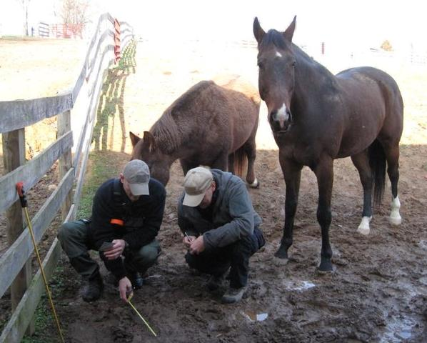
Obvious tracks are often found in “track traps”
Any location that may be particularly susceptible for receiving good track impressions.
Natural
  At the edge of water sources
  Under large trees
  Ant Hills
  Animal Dung
  Sandy, Muddy or Snow covered areas
Man Made
  Plowed Fields
  Fire Breaks
  Fences
  Dirt Roads
Notes:
Track traps are very important in sign cutting operations and for finding conclusive prints.

Slide 35
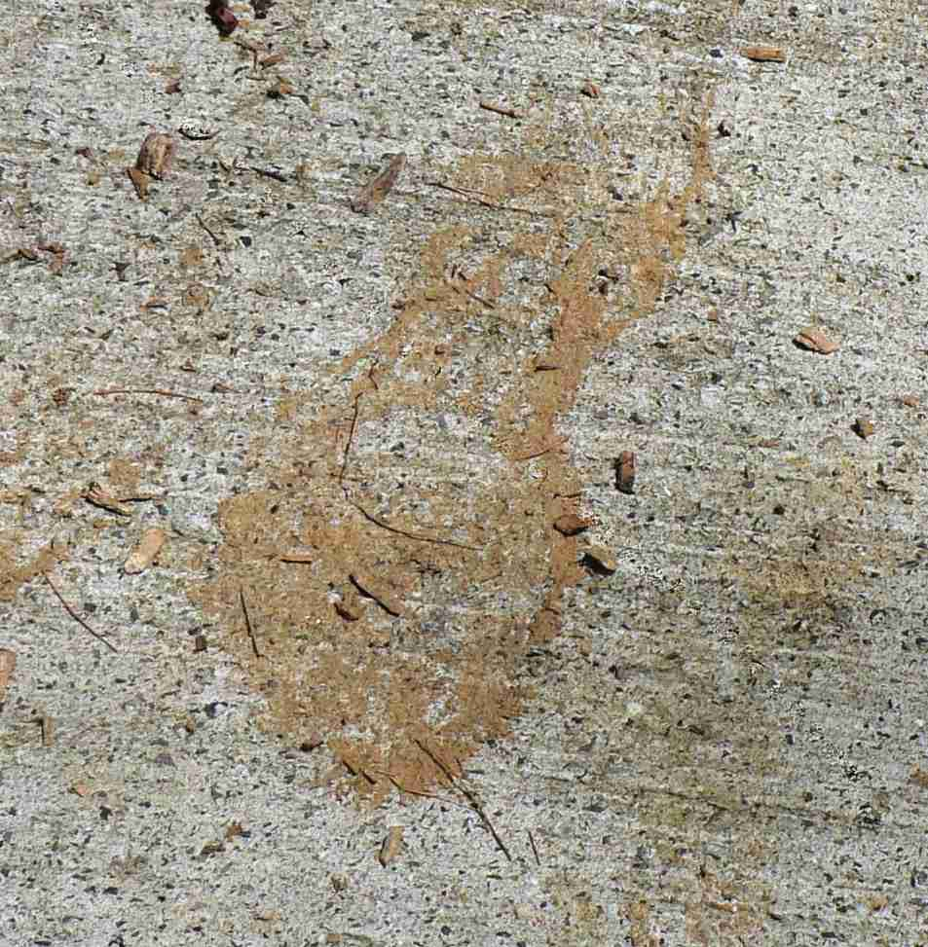
Examples of Basic Sign – Dirt Transfer:

Slide 36
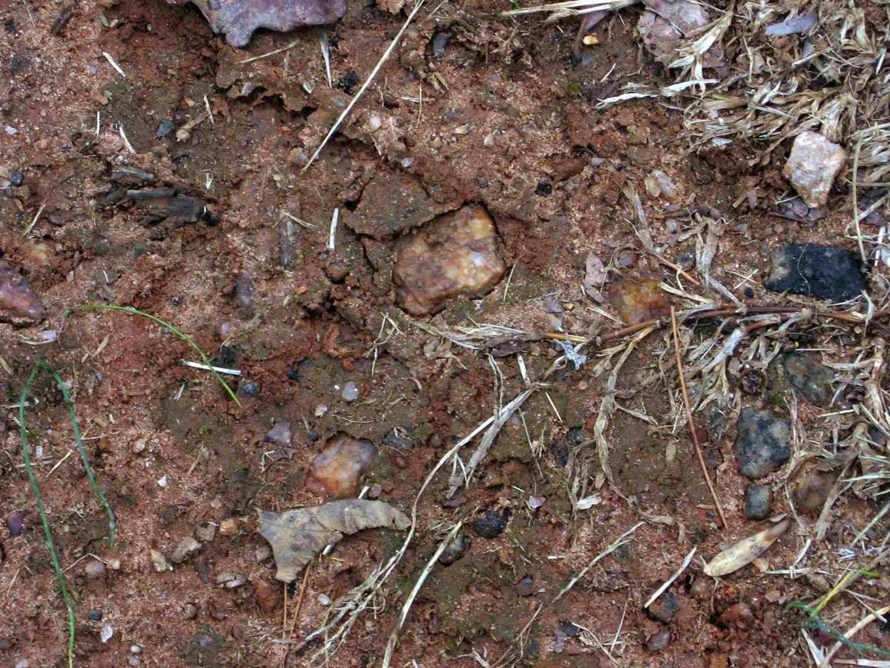
Examples of basic sign – Compression/Flattening:

Slide 37
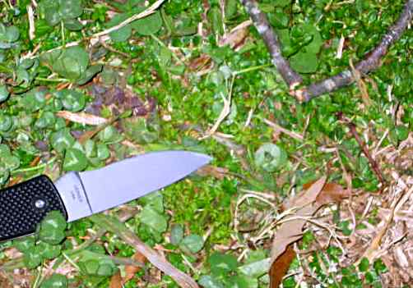
Examples of basic sign – Twig damage:

Slide 38
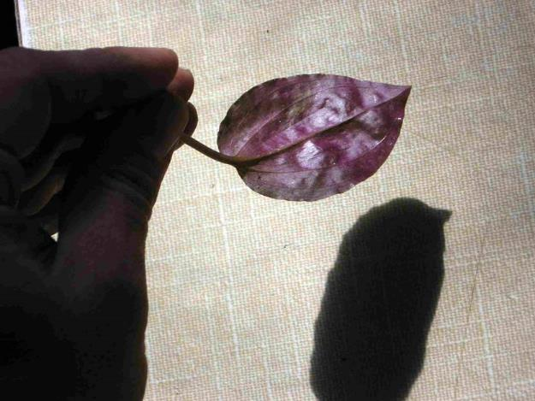
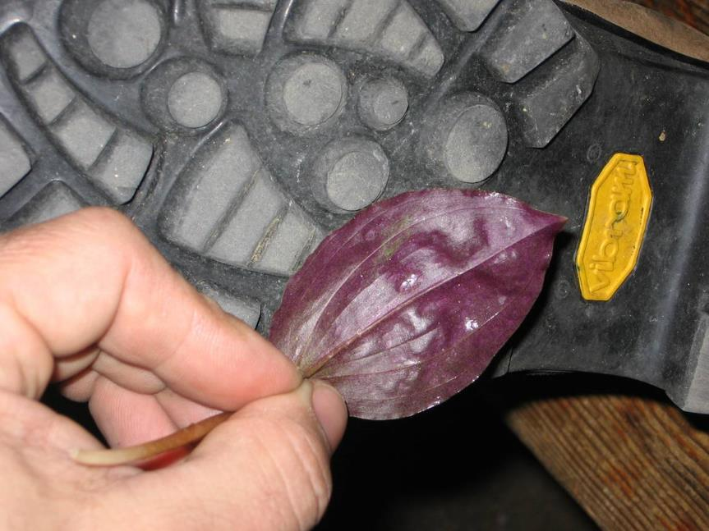
Examples of basic sign – Geometric Pattern in the woods?

Slide 39
There are many stories of the most green beginners being very successful
Small group of SAR team members had just completed brief introduction to tracking. Heading home, they were informed their SAR team was on an active search. Arrived asking to see if they could track. Search manager said they should wait and just join a regular ground crew. Allowed to take a look while waiting. Found tracks heading off in opposite direction from where the search was focused. Followed compressions, mashed and bent grass, partial heel marks and an occasional print. Found grandfather, hypothermic but well.
Near Hemet, California. 4.5 year old boy missing from families campsite. 4 days out, Joel Hardin called into assist. Joel was having difficulty making out sign through the 4 days of SAR tracks when an Explorer scout who had attended one day session introduced himself and led Joel to an 18” long sliding heel impression he had marked 4 days earlier. Joel and the scout picked up the trail and the boy was found less than 2 hours later.
Notes:
Only minimal tracking insight and knowledge may be required to produce dramatic improvements to search operations.

Slide 40
A tracking team should start with a thorough review of the facts
Reviewing the PLS/LKP and having brief discussions with IC and those closest to the lost person can get the tracking effort focused early in the search.
A tracker must treat all background information impartially.
  IC, Search team leaders, family and law enforcement will often try to describe in great detail WHAT a tracker should look for and WHERE a tracker should look. This information should be weighed and considered but…
  trackers MUST look for physical sign and follow where it leads… only.

Slide 41
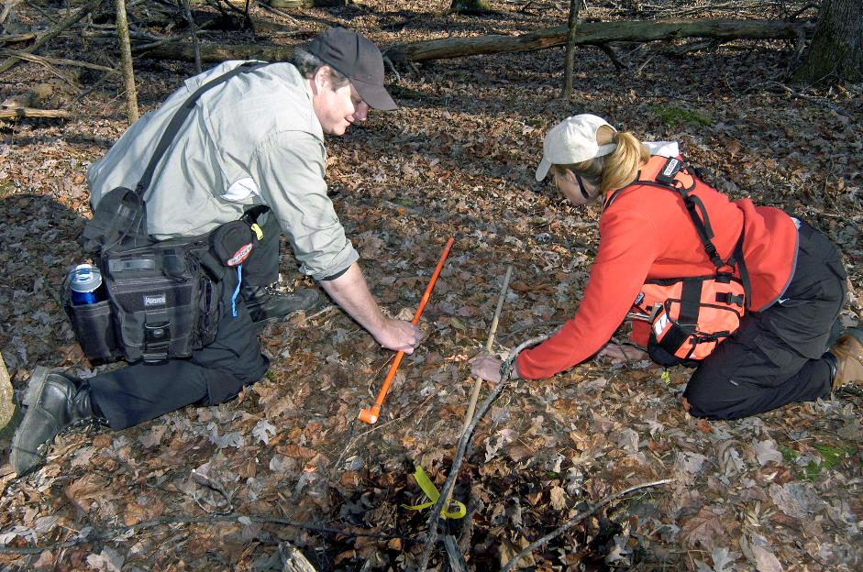
Tracking requires only limited equipment
The most critical tracking tool is the tracker’s BRAIN
  Learning to see what is there instead of what you think you should see is
    tracking stick will help you focus your attention
A tracking ready Pack:
  Note pad and pencils
  Small measuring tape
  Flagging tape/marker sticks
  Permanent Marker
  Compass / GPS
  Topographic Map
  Small Mirror
  Flashlight
  Tracking Stick / Sign cutting stick
Notes:
Be prepared! Arm yourself with knowledge and as much tracking practice as possible to help improve your search results.
Consider adding tracking components to your existing SAR ready pack and/or creating a new pack with just the fundamentals needed to perform basic tracking operations.

Slide 42

Tracking is conducted using the Step by Step method
Ab Taylor states the importance of using the step by step method as a CREDO:
  Do not advance beyond the current print until you find the next one
  Do not destroy the evidence.
  Use a sign cutting stick
  See rule #1
Any track or sign is considered evidence until proven otherwise.
Once a track or sign has been destroyed, it cannot be reconstituted and is lost forever.
Notes:
A primary goal is to teach Searchers to NOT obliterate important clues.
Becoming track-aware equips searchers with necessary skills to avoid destroying clues.
Once sign is destroyed, it cannot be followed.
As tracking skills are being practiced, the step by step method ensures good habits and skills are developed and helps reduce the chance that important clues are destroyed.

Slide 43
Ideally, a 3-person tracking team will be used with a point person and a flanker on each side
With a point person in front and a flanker behind and to each side, maximum sign can be found.
Advantages of a team:
  Allows for consultation in difficult situations.
  Team can be rotated to help control fatigue.

Slide 44
3-person tracking team
Prime Sign
Area
Point
Left Flank
Right Flank
Standard Tracking Team Structure

Slide 45
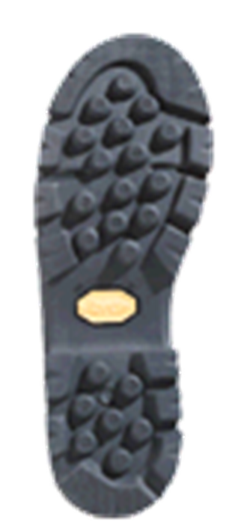
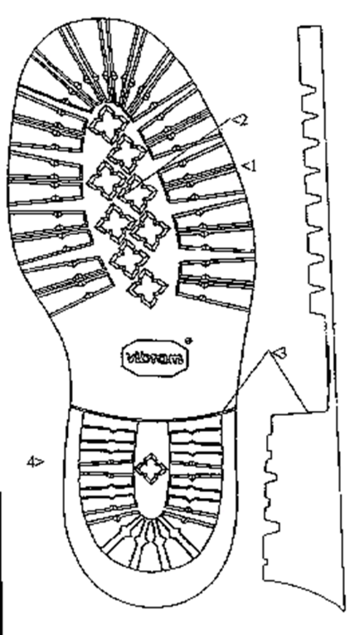
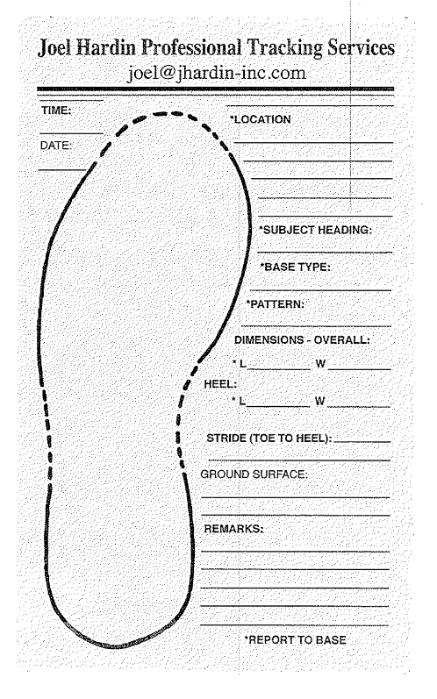
Use the standard print drawing form to record details on the first good print you find
Notes:
Handout / show / insert standard print recording form.

Slide 46
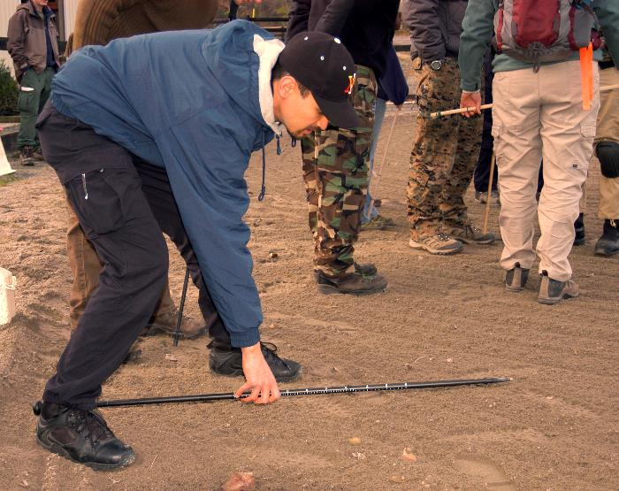
The tracking stick will be used to record track length, print width and stride length while tracking
Two O-rings or pieces of tape on a
broom handle, hiking pole or
specialized tracking staff is all that
is needed.
Use one o-ring to mark the print
length and the other to mark from the
toe of one print to the heel of the next print. This will be the length of the stride.
Use the stride marker as a reference then swing the tracking stick in a narrow arc to focus your search for the next sign.
The tracking stick focus your attention on a small piece of ground rather than a larger area
Notes:
This is a required tool and skill to be a successful tracker.

Slide 47
The use of the tracking stick is very straightforward

Slide 48

Using light correctly provides significant benefit to a tracker. The lower the angle, the better the contrast
Diffuse, rather than hot-white
Place the track between you and the light source when possible.
Make sure the light source is as oblique an angle as possible.
Keep a mirror in your tracking ready-pack to redirect sunlight even on the brightest days.
Don’t allow your search for the best lighting position to destroy any sign!
Headlamps attached to ankles or walking sticks is preferred by some trackers, for instance.

Slide 49
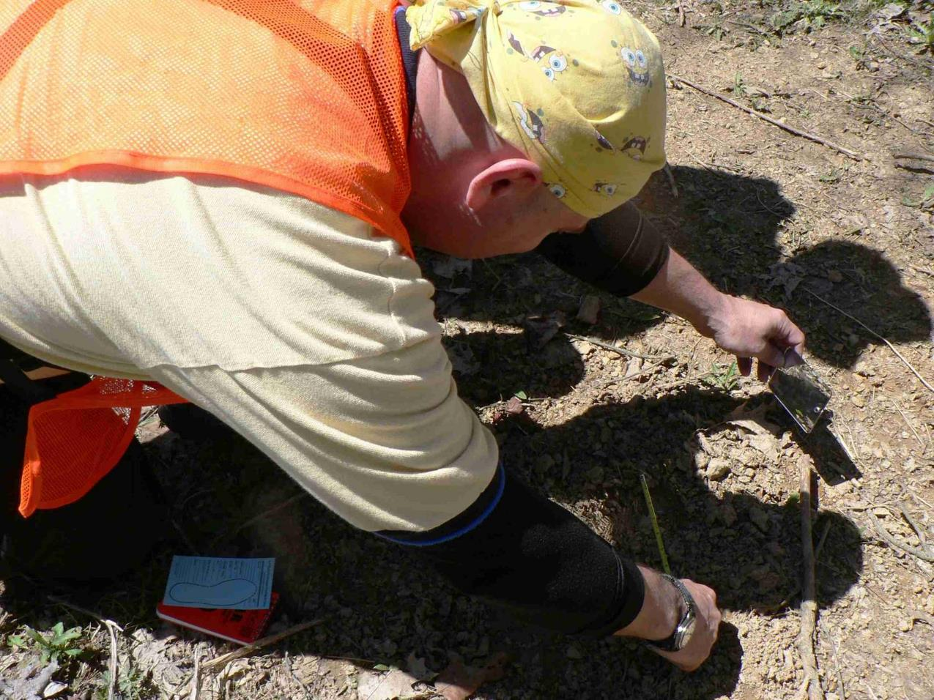
Notice the track being measured here?

Slide 50
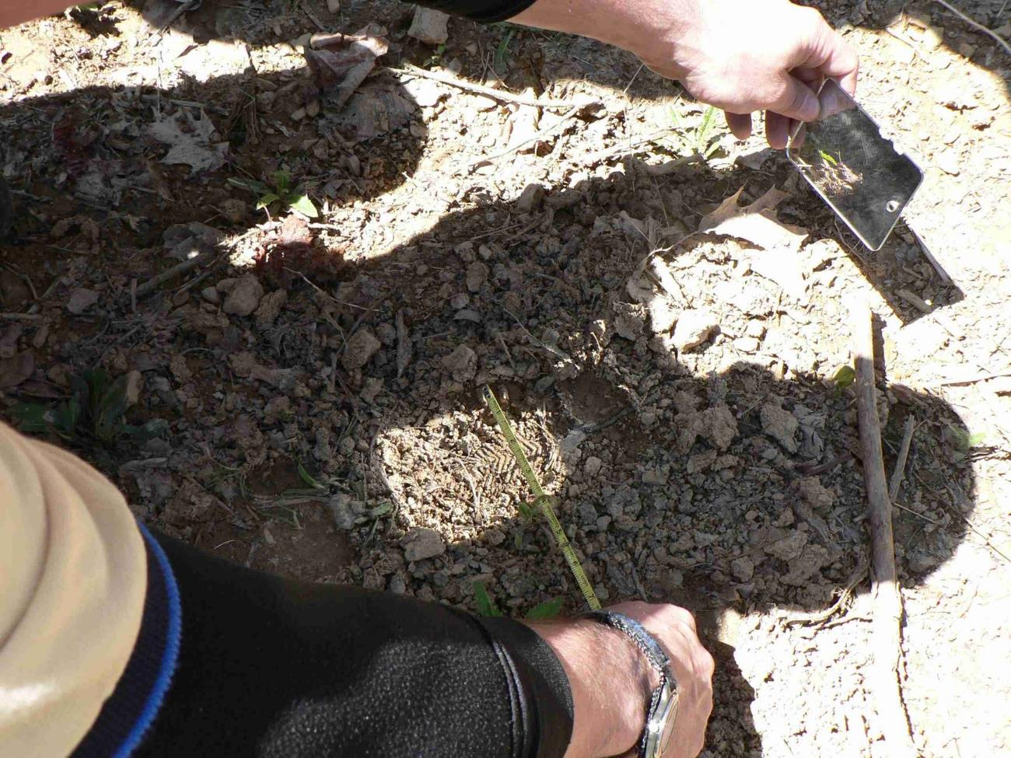
How about now ?

Slide 51

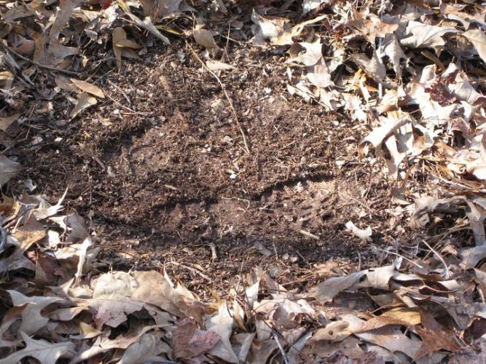
Mark each track only with a bit of biodegradable tape
Using a footprint card, you still draw the entire print in as much details as possible. Then place a piece of tape behind each heel mark.

Slide 52
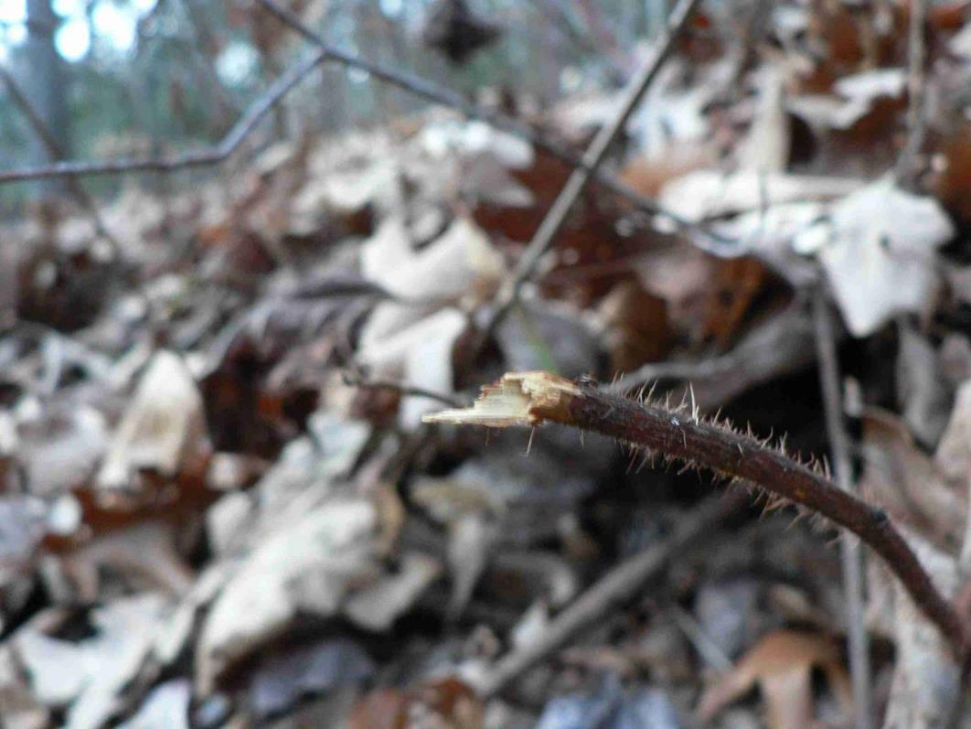
Examples of Sign – Fine twigs damaged:

Slide 53
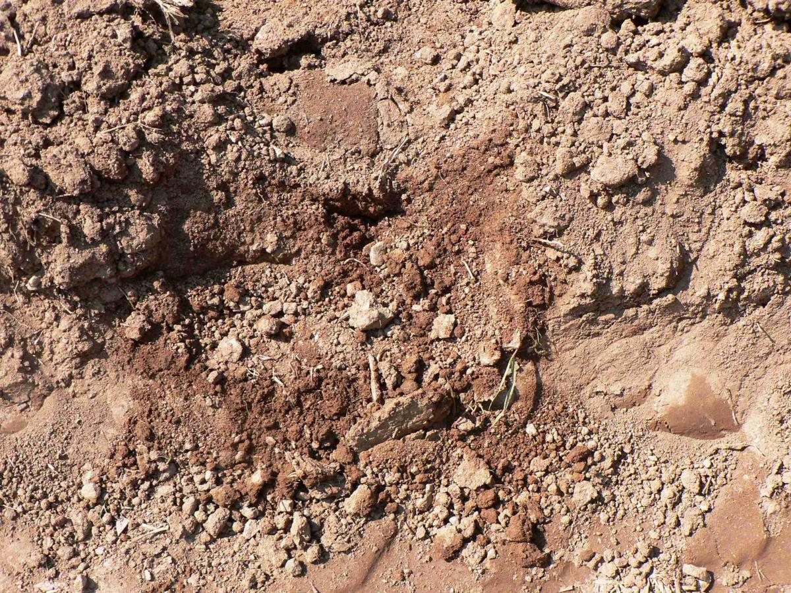
Examples of Sign – Scuffs and Scrapes:

Slide 54
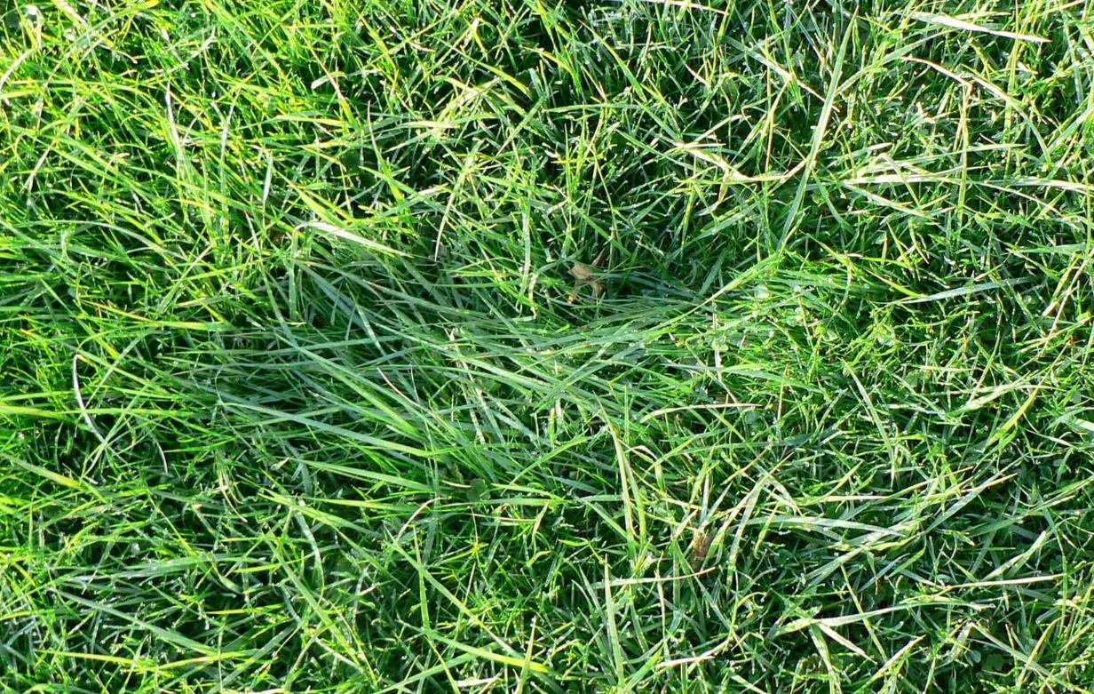
Examples of Sign – Compression:

Slide 55
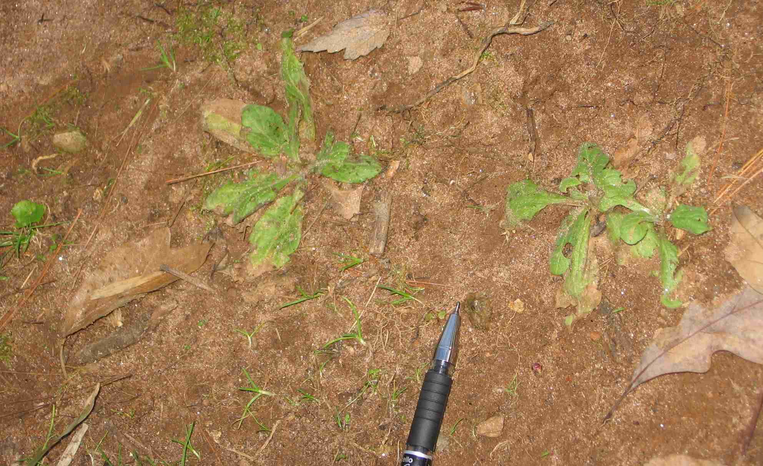
Examples of Sign – Heel Marks:
Notes:
Heel marks may be present when the remainder of the print isn’t.
Two persons, one in boots, the other in tennis shoes. The tennis shoe stepped over the print last. (booted person was in front or passed first).

Slide 56
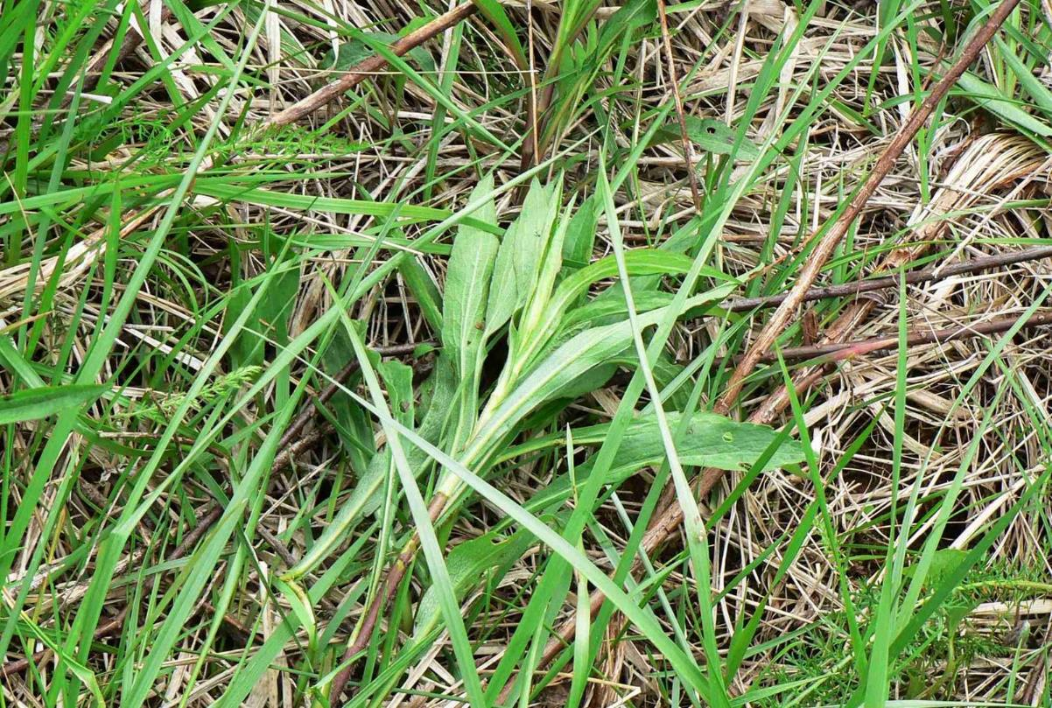
Examples of Sign – Flagging, example #1:

Slide 57
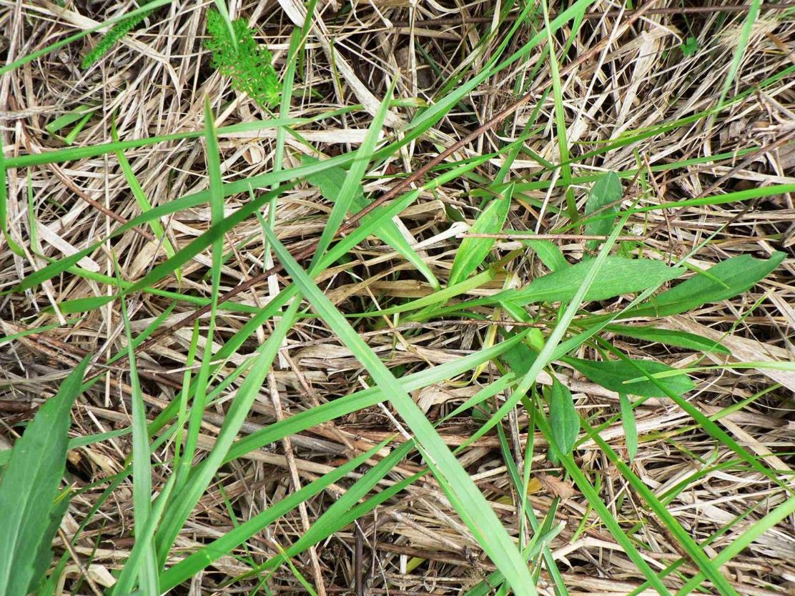
Examples of Sign – Flagging, example #2

Slide 58
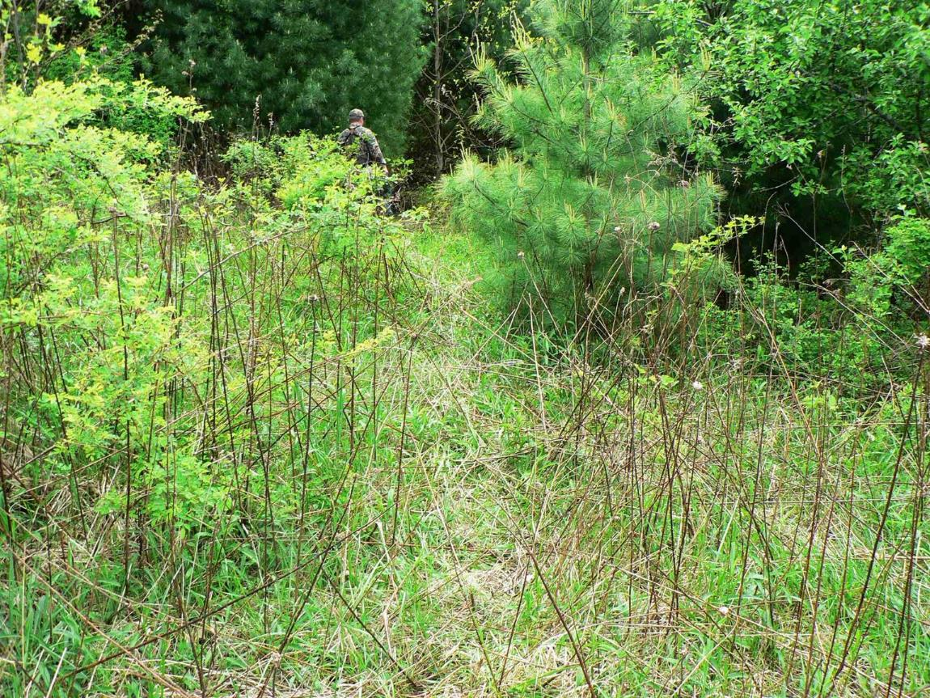
Examples of Sign – Shine

Slide 59
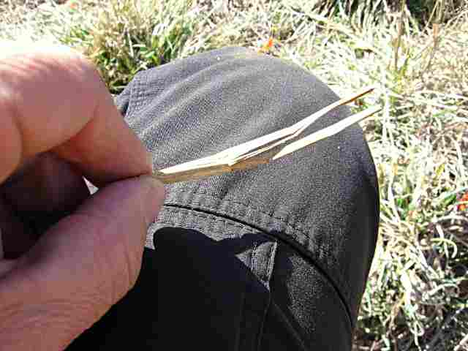
Examples of Sign – Grass Stalk Damage – Bent Stalk / Lug

Slide 60

Examples of Sign – Toe Mark

Slide 61
Aging sign and tracks is sometimes necessary to maintain a sign line
Any material or environment that can show sign will be affected by the forces of nature. These can be split into two broad categories, biological and mechanical.
Biological forces are those which affect living things and usually involve healing or decomposing.
  Fresh breaks, bruising, bending, and other natural disturbances can be studied.
Mechanical forces are those which cause sign to be obliterated over time. These can be either natural or man-made.
  Natural forces are air, sand, rain, dust, leaves, insects, snow, other animals, etc…
  Man-made forces are best described by searchers who are NOT track-aware. Especially well-intentioned searchers on knobby-tired clue erasers…of all types.

Slide 62

Examples of Sign – Aging Sign - Fresh

Slide 63

Examples of Sign – Aging Sign - Old

Slide 64

Night may be the best time to track.
Trackers have complete control of their light source.
Only the subject area is lighted so other distracting areas are eliminated and more focus given to the prime sign area.
The first incident operating period often starts in the evening around dark and trackers may be able to work fairly pristine PLS/LKP.
Tracking is often a slower process than a typical search assignment

Slide 65
How many hikers does it take to destroy delicate sign?
One, if they manage to locate and obliterate the only piece of sign available with one tire, step or stumble
Possibly more than 100, if conditions are favorable
Mark Gleason, a JHPS tracker, had identified a single set of tracks and followed them until a group of hikers approached. He sat and watched as 3 groups totaling 97 hikers passed through where he was tracking
6 tracks still survived

Slide 66

To stay on track, learn how to read sign to find the location of the next sign, even when difficult
Look in all directions. Sign and tracks aren’t two dimensional
Sign cutting (NOT “Track Jumping”)
Reading track sign correctly will help you focus on subsequent clues and to STAY ON TRACK
Don’t look for the whole, look for the parts. When the parts are found, the whole can be compiled.
HINT: Sometimes you may be able to determine where sign is NOT to help focus on the correct sign
Notes:
This is the first more technical slide. It is a simple introduction of compression and pressure releases and where to look for sign. Covered in much more detail in the overview section and the skills section.
True print is the actual impression at the base of the track, excluding the wall and outlying area.
The wall is the sides of the track and will normally have specific marks that indicate what the foot was doing as it stepped down and as it was pulled out of the track.
Ridges can be formed on a wall that will indicate speed, direction, urgency, etc…
Disks form on the bottom of a print. They are circular areas that break free and slide together. They provide important information on the pressure, speed and direction.
Plates form on the outer ridge of a track wall. They can be whole, have fissures in them, crumble on the edges or explode out, all indicating greater evidence of the speed, direction and actions of the lost person….and most importantly, where to look for the next track!!
Secondary releases indicate footpads or print sections that have more than one layer of pressure release information. For a barefooted person or animal, each digit provides a full compliment of pressure release information.
Each release characteristic can be measured in 1/8th of an inch so this study can easily move into 5000 or more subtle differentiations for each track.

Slide 67

Tracking skills require much practice to improve
Team approach will assist in learning and performance.
“Dirt – time” spent studying tracks, compression information and specific pressure release characteristics is a must to progress as a tracker.
A “track box” is suggested by some to allow practice year round. Also allows careful study aging and other effects in a controlled setting or to gain some practice even during inclement weather.
Notes:
The introduction to reading tracks was discussed under becoming track aware.
Extensive knowledge can be obtained, through practice.

Slide 68
A few Tracking Myths
The average person is unable to learn the necessary skills to be effective (or an almost supernatural insight is required).
Search leaders or IC are the best persons to determine if tracking could be effective.
Tracks disappear in the rain or inclement weather.
Tracks are easily contaminated by family and searchers and this destroys the ability for tracking to be useful.
The subject is believed to have traveled mostly hard surfaces so no track evidence will be available.
Forest floors covered in leaves will not be trackable.
Notes:
This is the old thought that apache scouts took tracking secrets to their graves and they largely used a mystical approach. The fact is that improvements in tracking skills, tracking tools, tracking process and tracking education can put just about any highly motivated person in league with the scouts of lore. Many brand new and largely untrained trackers are routinely successful and “save the day”. A chart is presented later in this section describing two such examples.
Only trackers can determine when to call off a tracking effort.
With 3,000 clues left per mile, a high percentage of all tracks, and ALL tracks at the PLS could be completely obliterated and tracking can still be used very successfully. Rain, sleet and snow can actually improve the track record, by the way…
It is nearly inconceivable that a person could spend any significant time moving through an area, with any ground covering – regardless of how hard the surface is, without leaving some sign and regular indications. The occasional area that is considered very tough to track through can be overcome through sign cutting, even if the trackers skill is insufficient to track every step. Also, see point #2.
Hard surfaces, even if the entire track is on a hard surface, is track-able. Linoleum and hardwood floors are track[able in many cases. Just place your sight line low enough with proper lighting and you will be amazed what you can see. One study showed that investigations of 35% of the burglaries in several cities over several years included solid footprint evidence from INSIDE homes that were robbed.
with the proper lighting and angle, forest floors show numerous tracks. With practice, you will even be able to tell what animal will leave what type of track. At the surface, you will see leaves with different colors from being jostled or turned over, bruised vegetation and slight indentions. If you feel the indentions, you can make out digits/animal or edges/prints. Carefully removing the top layers of leaves will allow you to see much detail and read the tracks quite readily.

Slide 69
Summary
We have reviewed a basic search approach and how important looking for clues and tracks are, compared to just looking for a person or body.
Tracking skills must be practiced to become proficient at finding clues, then progress to reading sign.
Keep within limits of your expertise. Do not be tempted or drawn to presume or state more than you have personally discovered or are certain of.
Tracking is an important skill that can be a valuable resource on every callout.

Slide 70


Credit and Thanks
Special Thanks to Mark Young, GTA – some of the slides/photography is his.
Thanks to R. Michael Carter for edits and additions to search management sections, CPAAA, and updating the resources.
Mostly everything else is directly or indirectly from Jim Greenway (Mountain Pathfinder), NASAR and Joel Hardin (Joel Hardin Professional Trackers).
Notes:
Although no more than a few words at a time may have been directly pulled from any published source, this presentation is definitely a compilation of thoughts and print written by others with vast knowledge in this field. Normal citations are omitted and this broad thank you is provided because this is intended for our own internal team training where presenters have direct access to these copyrighted materials, and no commercial benefit of any kind will be solicited in anyway.

Slide 71

Questions?
Gwinnett CERT – Clue Awareness - 2008

Slide 72
RESOURCES AND ADDITIONAL INFORMATION

Slide 73
Resources
Mark Young, Georgia Trackers Alliance (a tracking organization currently forming in support of the SE US region), markjyng@cs.com, http://www.georgiatrackers.org/
Joel Hardin Professional Trackers, https://www.jhardin-inc.com/web/
Rob Speiden, Natural Awareness Tracking School, http://www.trackingschool.com/instructors/rob-speiden
Search and Rescue Tracking Institute, http://www.sarti.us/WP/
TRAC – Tracking Atlantic Coast, http://trackingatlanticcoast.com/about_trac
National Association of Search and Rescue (NASAR)
http://www.nasar.org/

Slide 74
Books and
Web
Addresses
Jack Kearney
  “Tracking – A blueprint for learning how”
Robert Speiden
  “Foundations for Awareness, Signcutting and Tracking”
Joel Hardin
  “Universal Training Systems”
  “Tracker – Case files of a professional Mantracker”
Ab Taylor
  “Fundamentals of Man-Tracking”
Robert Koester www.dbs-sar.com
  “Lost Person Behavior”
  “Man-Trackers and Dog Handlers”
  “Modeling the Movement of Lost People”
David Scott Donelan
  Tactical Tracking Operations
David Diaz
  “Tracking - Signs of Man, Signs of Hope”
Paul Rozendes
  “Tracking and the Art of Seeing”
National Association of Search and Rescue – Many helpful text books and manuals

Slide 75
Tracking checklist:
Control vehicle or foot traffic in high probability areas
Look early in hazardous, high probability, easy to track areas – still use the step by step method – only – no track jumping! – connect to LKP
Cut for sign within the confined area and be prepared to rule out an area if a perimeter is cut thoroughly and no sign is found
Check along trails and roads on approach
Get as much information as possible before beginning tracking operations and deal only with facts. Use a working theory but substantiate with facts.
One or two trackers cut sign initially to help protect sign
Preserve all evidence, learn to read behavior. Flag and return clues as appropriate.
Use the step by step method – only – no track jumping!

Slide 76

Summary of sign and visual clues
Flattening / compressions
  Shine
  Crushed Vegetation
  Broken or crushed dirt clods
  Imbedded twigs and rocks
Regular Patterns
  Geometric
  Any regularity or repeated disturbance
Color Change
  Transfer of material
  Bruising
  Scuffing
  Clouded Water
Disturbance
  Discarded Items
  Dewdrops missing
  Vegetation Damage
  Rocks/Twigs dislodged
  Defecation
Consider any type of Visual Clue:
  Disturbance
  Staining or Transfer
  Weathering
  Littering
  Camouflage
Outline
Shape
Contrast
Color
Texture
Notes:
Several hours or even days can be spent on this slide and the next several slides of pictures, depending on the needs, interest and time class participants have.
At a minimum, step through each type here, possibly starting with the lower right section, and walk through each one describing briefly what would be looked for and getting everyone to consider where they have seen this type of sign before. Nearly everyone will have seen these, but just not acted on them.
The picture is a good demonstration of shine. Low light shining from the bent path, clearly indicating direction of travel.

